Slide 1

PaaS Lunch & Learn Series
- Platform Infrastructure -
March 21, 2023
sebastian.klingberg@magnolia-cms.com

Slide 2
Table of contents
Crash Course Kubernetes
Magnolia Helm
01
02
K8s Operators
03
04
Magnolia PaaS
05
Q&A Session

Slide 3
01
Crash Course Kubernetes
Notes:
https://jira.magnolia-cms.com/browse/HELPDESK-3754

Slide 4
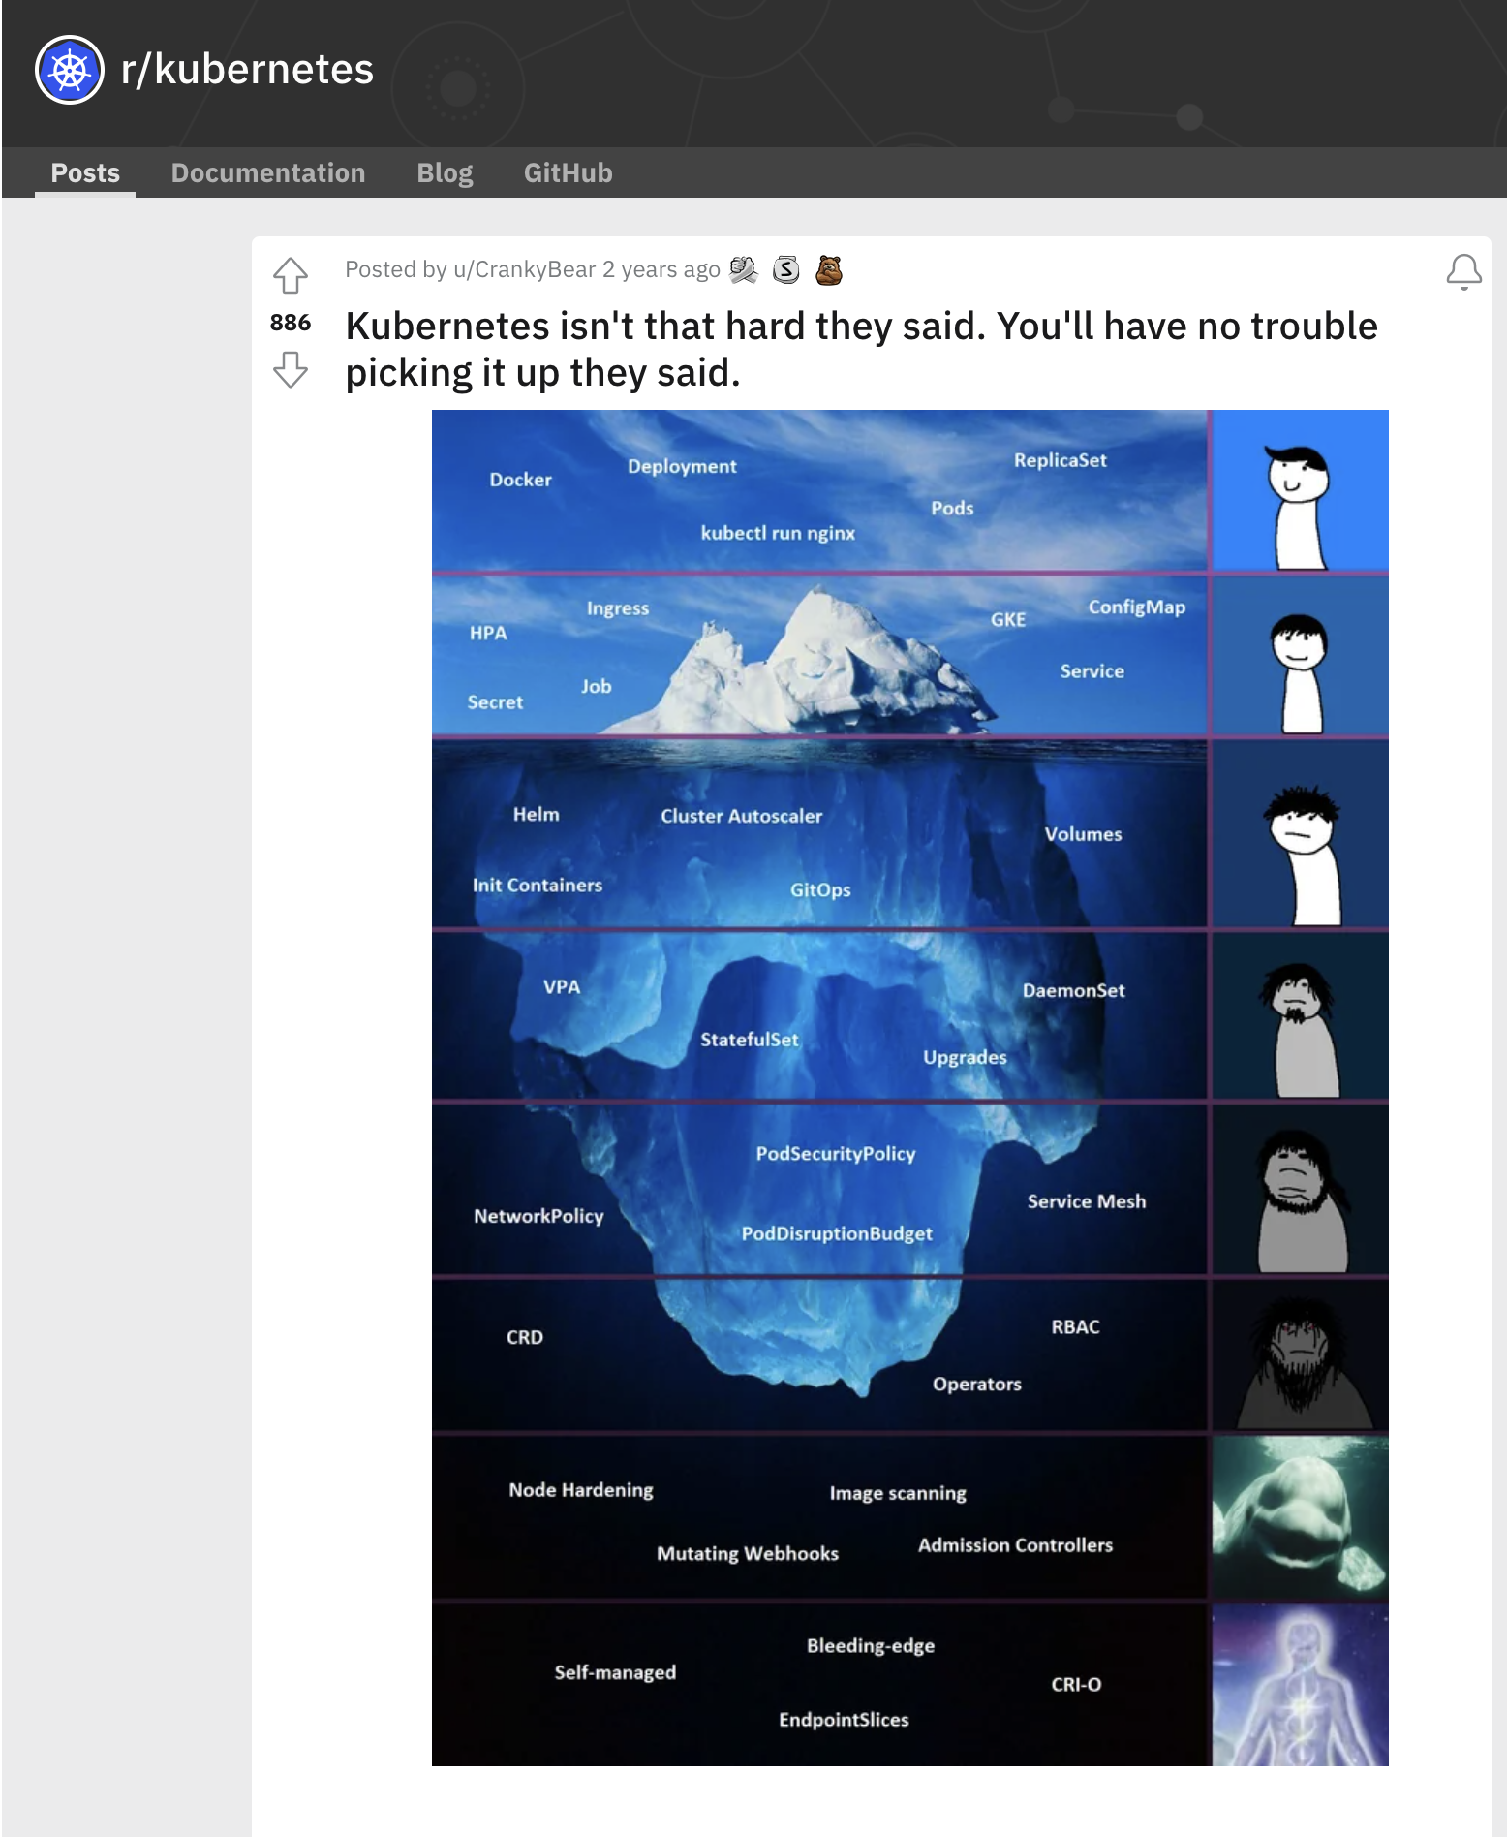

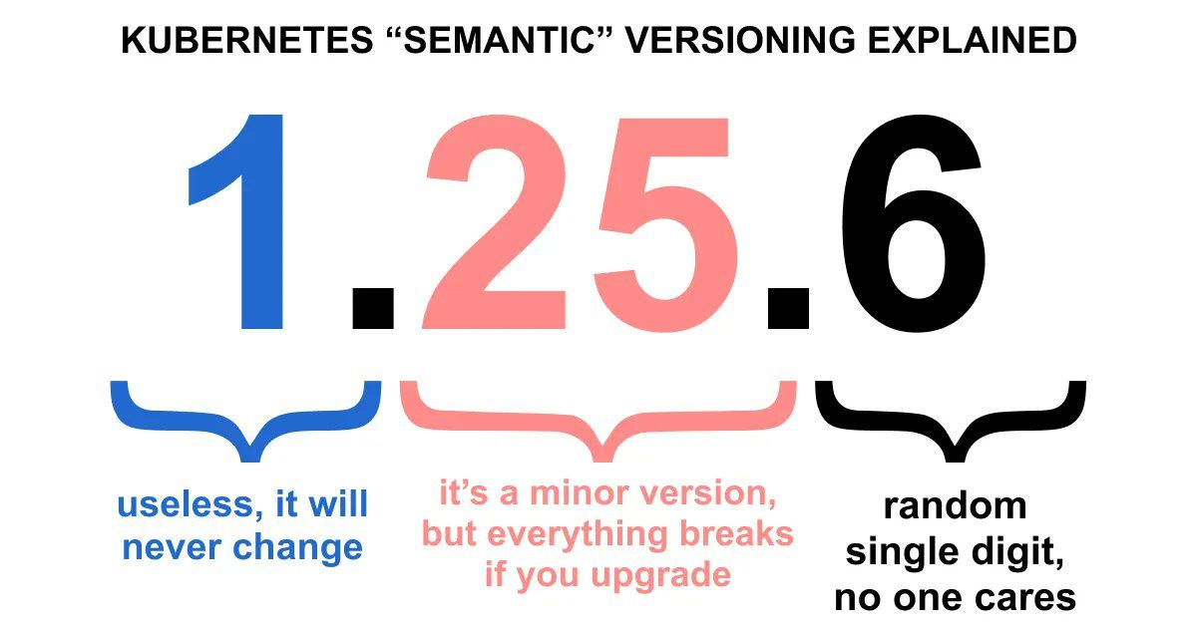
… only the tip of the Iceberg
REST API managing K8s Resources
… declarative YAML!
… masses of more solutions around K8s
https://landscape.cncf.io/
~4 Months Release Cycle
By today: Kubernetes v1.26
Source
Source
Source
Notes:
Cloud-provider specific fun
K8s Ressources
YAML actually stored in JSON in ETCD

Slide 5
Crash Course K8s (PaaS Focus)
why-you-need-kubernetes-and-what-can-it-do (by the project)
what-kubernetes-is-not (by the project)
Kubernetes-Fundamentals
Explain K8s Core Components
Few words on Rancher
Containers, Pods, Sidecars
Deployments, StatefulSet, Daemonset
Service
Ingress
Store Data in K8s: PV/PVC, ConfigMap, Secrets
Notes:
How2Access API? accessed via Kubectl (Cert/Token) → Rancher

Slide 6
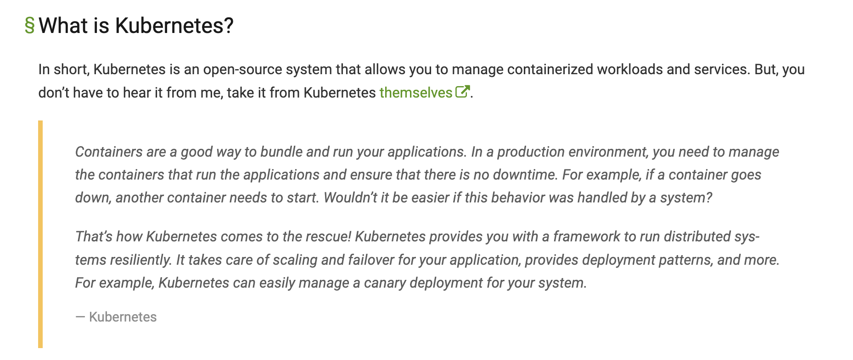
Source

Slide 7
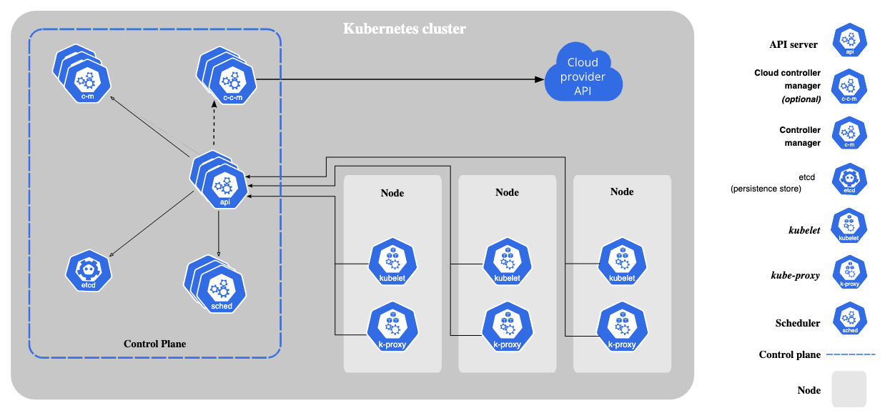
K8s Core Components
Note: Control Plane is usually managed by CloudProvider (EKS,AKS, GKE, ….)
Source
Notes:
Control Plane Components
The control plane's components make global decisions about the cluster (for example, scheduling), as well as detecting and responding to cluster events (for example, starting up a new pod when a deployment's replicas field is unsatisfied).
Control plane components can be run on any machine in the cluster. However, for simplicity, set up scripts typically start all control plane components on the same machine, and do not run user containers on this machine. See Creating Highly Available clusters with kubeadm for an example control plane setup that runs across multiple machines.
kube-apiserver
The API server is a component of the Kubernetes control plane that exposes the Kubernetes API. The API server is the front end for the Kubernetes control plane.
The main implementation of a Kubernetes API server is kube-apiserver. kube-apiserver is designed to scale horizontally—that is, it scales by deploying more instances. You can run several instances of kube-apiserver and balance traffic between those instances.
etcd
Consistent and highly-available key value store used as Kubernetes' backing store for all cluster data.
If your Kubernetes cluster uses etcd as its backing store, make sure you have a back up plan for those data.
You can find in-depth information about etcd in the official documentation.
kube-scheduler
Control plane component that watches for newly created Pods with no assigned node, and selects a node for them to run on.
Factors taken into account for scheduling decisions include: individual and collective resource requirements, hardware/software/policy constraints, affinity and anti-affinity specifications, data locality, inter-workload interference, and deadlines.
kube-controller-manager
Control plane component that runs controller processes.
Logically, each controller is a separate process, but to reduce complexity, they are all compiled into a single binary and run in a single process.
Some types of these controllers are:
Node controller: Responsible for noticing and responding when nodes go down.
Job controller: Watches for Job objects that represent one-off tasks, then creates Pods to run those tasks to completion.
EndpointSlice controller: Populates EndpointSlice objects (to provide a link between Services and Pods).
ServiceAccount controller: Create default ServiceAccounts for new namespaces.
cloud-controller-manager
A Kubernetes control plane component that embeds cloud-specific control logic. The cloud controller manager lets you link your cluster into your cloud provider's API, and separates out the components that interact with that cloud platform from components that only interact with your cluster.
The cloud-controller-manager only runs controllers that are specific to your cloud provider. If you are running Kubernetes on your own premises, or in a learning environment inside your own PC, the cluster does not have a cloud controller manager.
As with the kube-controller-manager, the cloud-controller-manager combines several logically independent control loops into a single binary that you run as a single process. You can scale horizontally (run more than one copy) to improve performance or to help tolerate failures.
The following controllers can have cloud provider dependencies:
Node controller: For checking the cloud provider to determine if a node has been deleted in the cloud after it stops responding
Route controller: For setting up routes in the underlying cloud infrastructure
Service controller: For creating, updating and deleting cloud provider load balancers
Node Components
Node components run on every node, maintaining running pods and providing the Kubernetes runtime environment.
kubelet
An agent that runs on each node in the cluster. It makes sure that containers are running in a Pod.
The kubelet takes a set of PodSpecs that are provided through various mechanisms and ensures that the containers described in those PodSpecs are running and healthy. The kubelet doesn't manage containers which were not created by Kubernetes.
kube-proxy
kube-proxy is a network proxy that runs on each node in your cluster, implementing part of the Kubernetes Service concept.
kube-proxy maintains network rules on nodes. These network rules allow network communication to your Pods from network sessions inside or outside of your cluster.
kube-proxy uses the operating system packet filtering layer if there is one and it's available. Otherwise, kube-proxy forwards the traffic itself.
Container runtime
The container runtime is the software that is responsible for running containers.
Kubernetes supports container runtimes such as containerd, CRI-O, and any other implementation of the Kubernetes CRI (Container Runtime Interface).
Addons
Addons use Kubernetes resources (DaemonSet, Deployment, etc) to implement cluster features. Because these are providing cluster-level features, namespaced resources for addons belong within the kube-system namespace.
Selected addons are described below; for an extended list of available addons, please see Addons.
DNS
While the other addons are not strictly required, all Kubernetes clusters should have cluster DNS, as many examples rely on it.
Cluster DNS is a DNS server, in addition to the other DNS server(s) in your environment, which serves DNS records for Kubernetes services.
Containers started by Kubernetes automatically include this DNS server in their DNS searches.

Slide 8
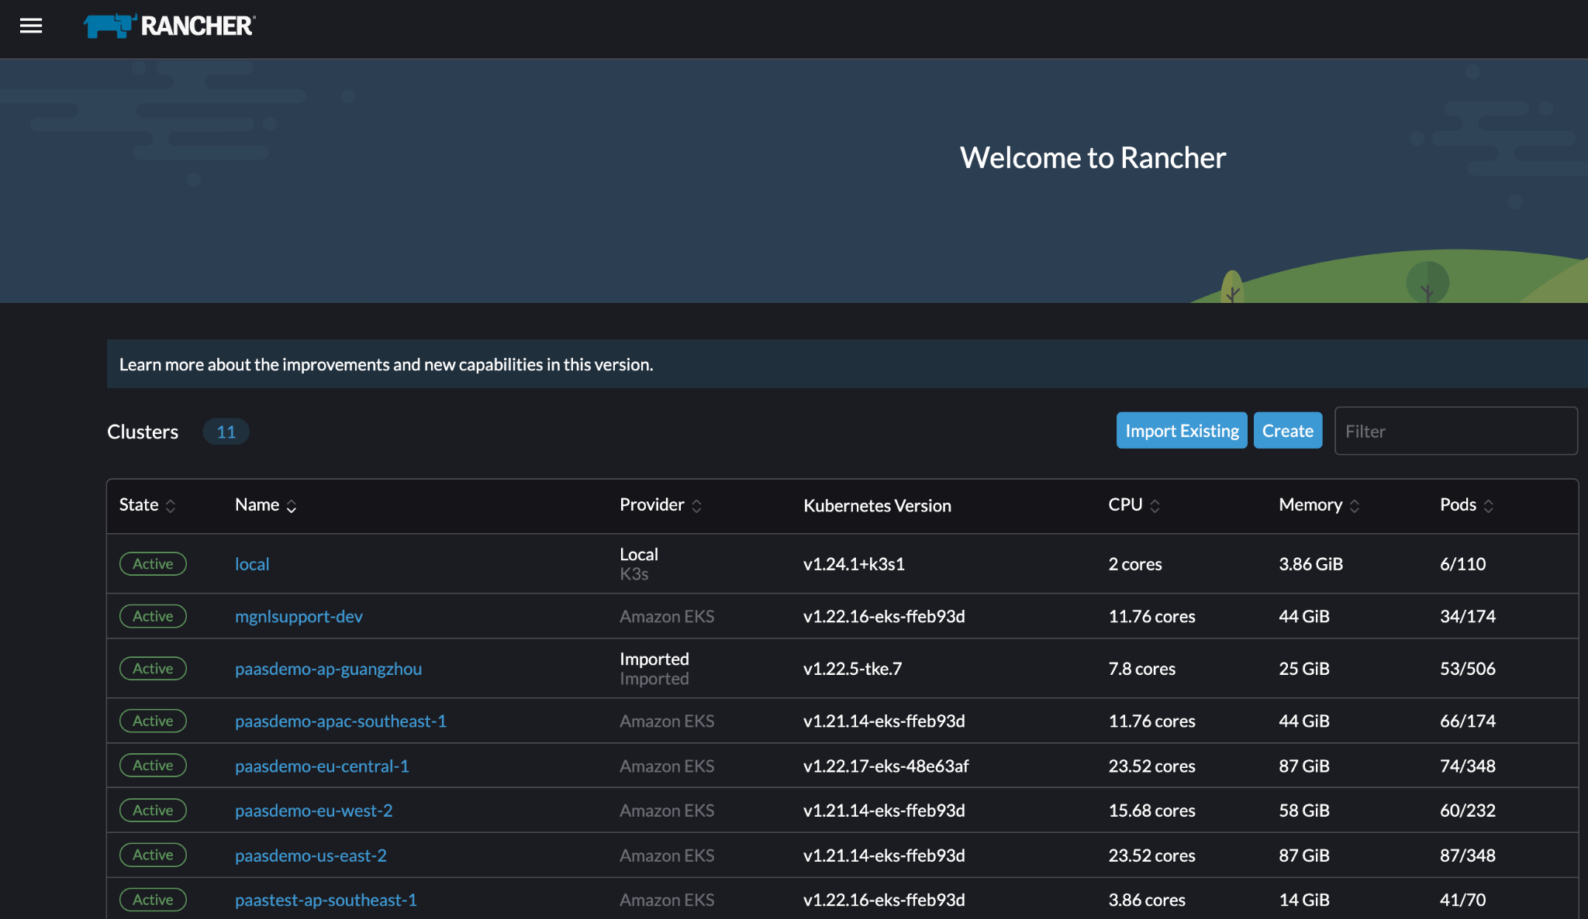
Few words on Rancher
Open-Source Project
Enterprise Version RancherLabs acquisition by SUSE in 07/2020
Highly used in productive Cloud-based and On-Prem (RKE/RKE2) Kubernetes Clusters
Organized in “K8s-Style” itself (API and Objects, stored in ETCD)
We use Rancher in Magnolia PaaS for:
Manage K8s Clusters on different providers
Cloud/K8s Agnostic (“cattle-system”)
Convenient WebUI
Centralized Access Management
Agnostic K8s API for Magnolia Cockpit
Comes with Automation via Fleet
“local“ K3s - lightweight K8s distribution
… Always a bit behind K8s Release Cycle

Slide 9
Demo Basic Kubernetes Webserver

Slide 10
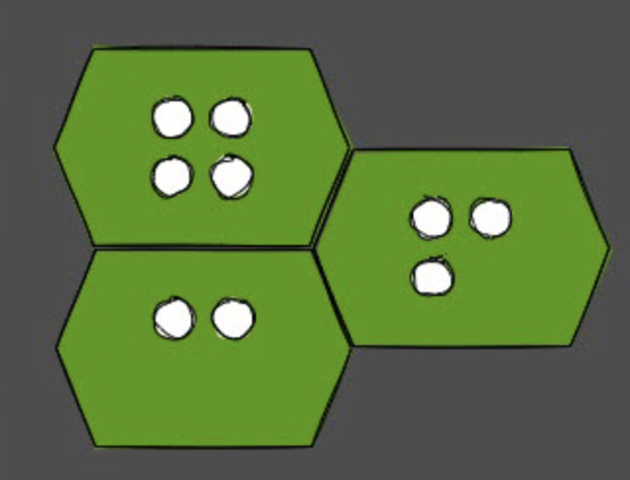
Pods & Containers
Pods are a Kubernetes Resource (Object)
K8s Ressources separated in Namespaces
One Pod consists of one or more containers
initContainer and Sidecars
Containers = OCI Images (“Dockerfile build)”
Kubelet will get Images and manage Runtime
Pods are considered ephemeral workload
Probes
StartupProbe = Initial Probe
LivenessProbe = Need Restart?
ReadinessProbe = Ready for traffic
Pod
Container
Source
Notes:
Show Pod
Show order default container
Delete Pod will disappear
Show K8s Ressource via describe
Modify name (not working), status used by K8s itself

Slide 11
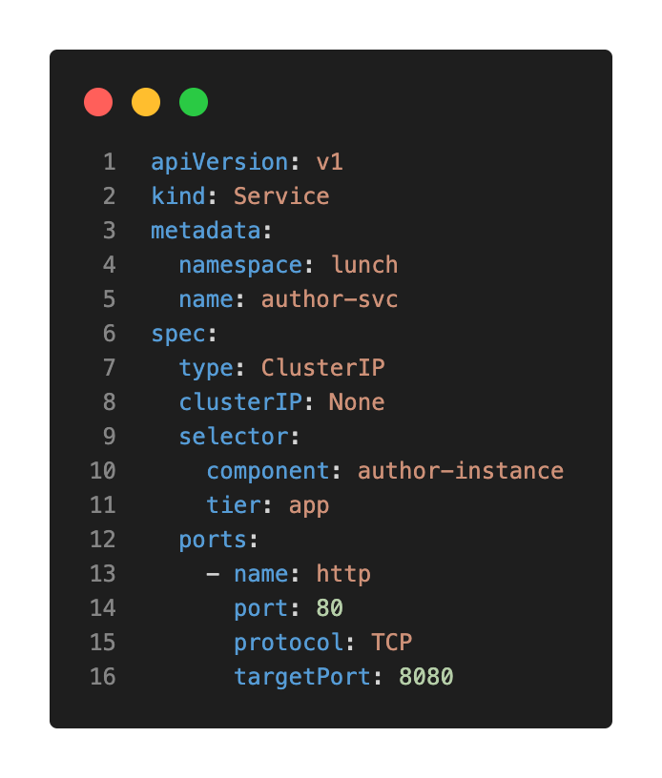
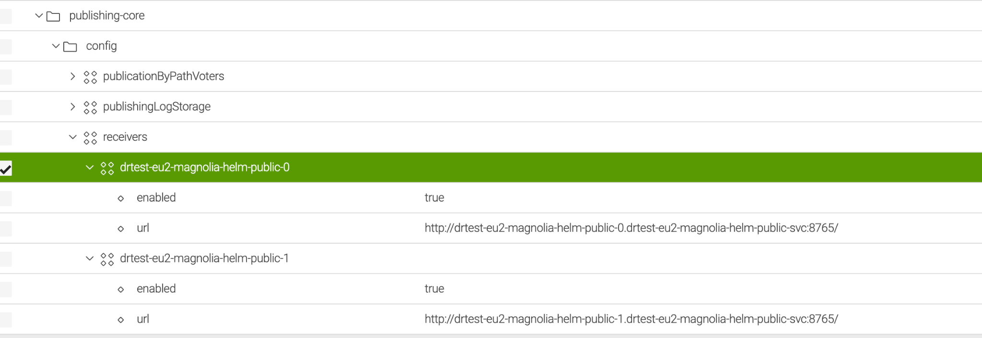
Services
Service register Pods ready to serve traffic
Services - usually - using label selectors (tags)
Readiness Probes to register Pods for a Service
Different Types of K8s Services:
ClusterIP for Intra-Cluster Communication (default)
Load Balancer configures a (cloud) Load Balancer
We use Ingress-Nginx Controller
K8s DNS (Cluster DNS)
Magnolia Author/Public Instances talks through services
Ie. configured as public receivers
Example: Headless Service Example
Source
Notes:
Readiness Probe Example
Difference Stable-Network-ID

Slide 12
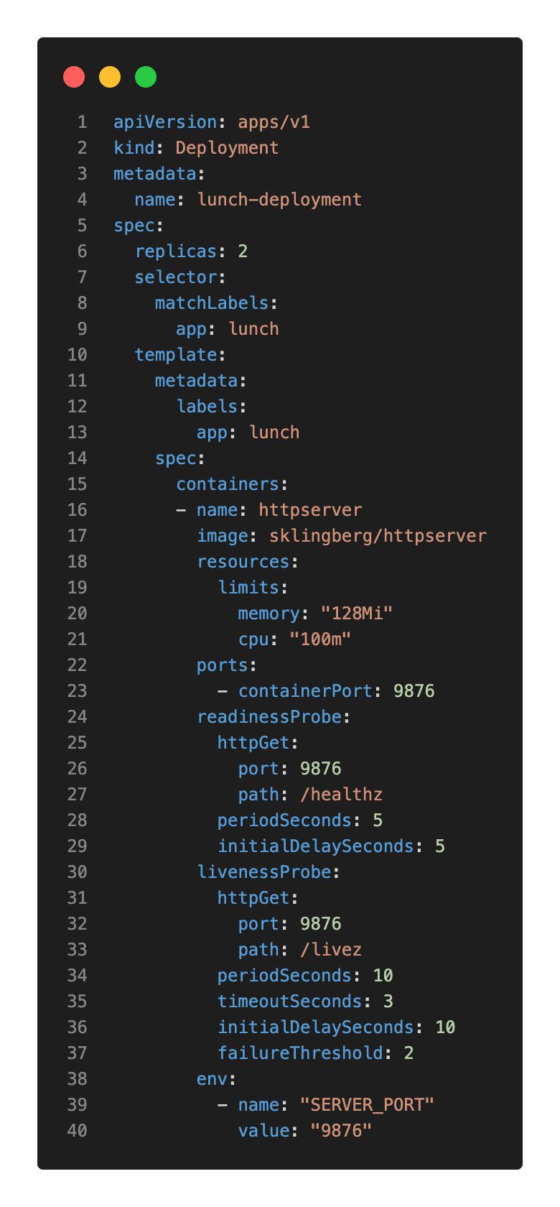
Workloads: Deployments (1/3)
Organize Pods in a (scalable) way
Set Replica value on demand
Deployments are used for stateless Applications
Examples:
Frontend Application
Operators
Same Options as Pods + more
Docs K8s Deployment
Ressources Limits/Requests
Best-Practises Memory/CPU Limits
CPU: Set no Limit, but may Requests
Memory: Equal Limit/Request Ratio considered “Guaranteed”
Align with application! (JVM, JS )

Slide 13
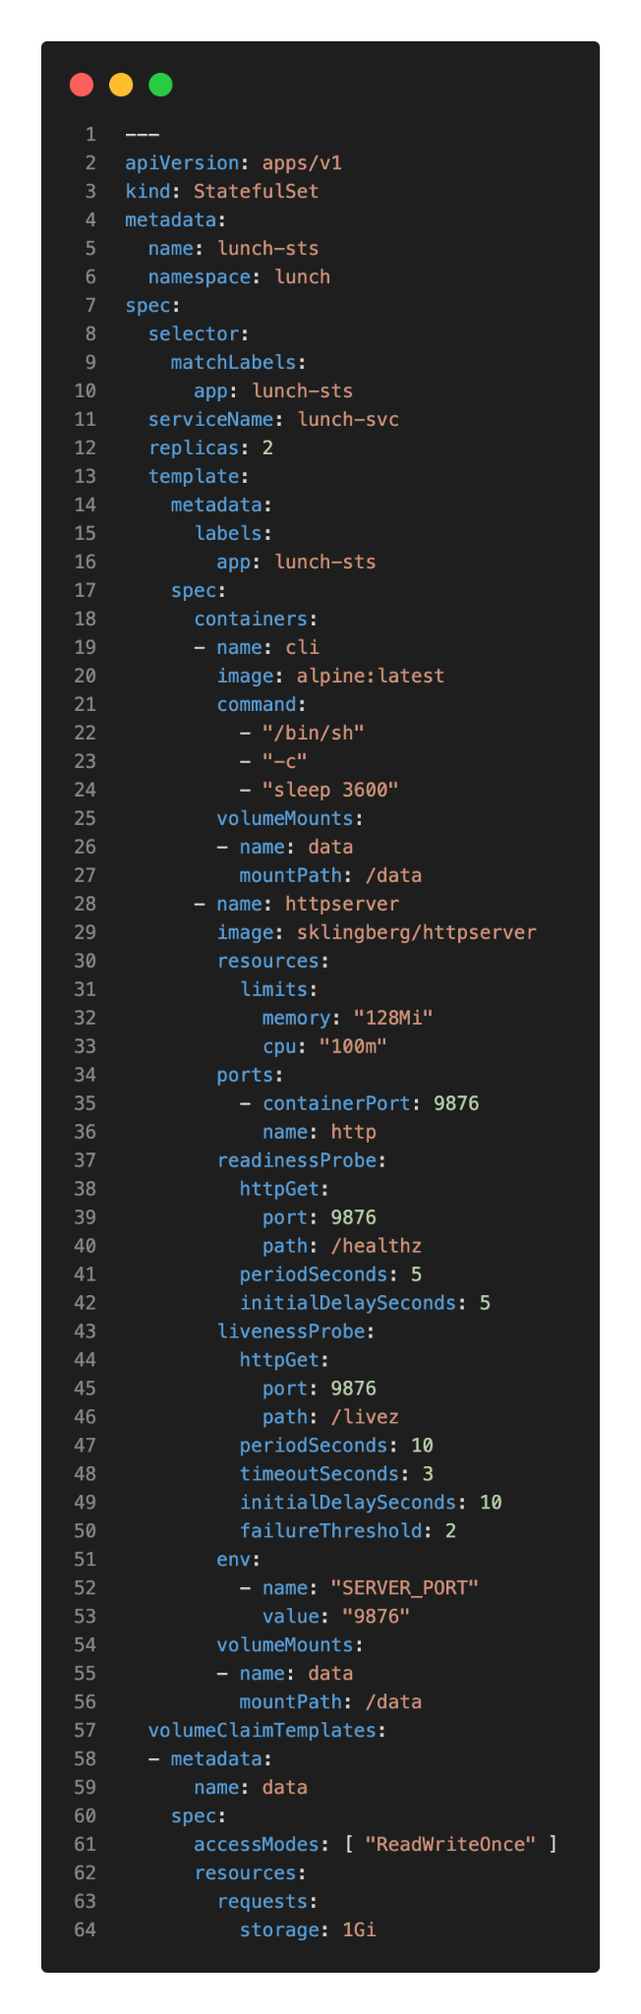
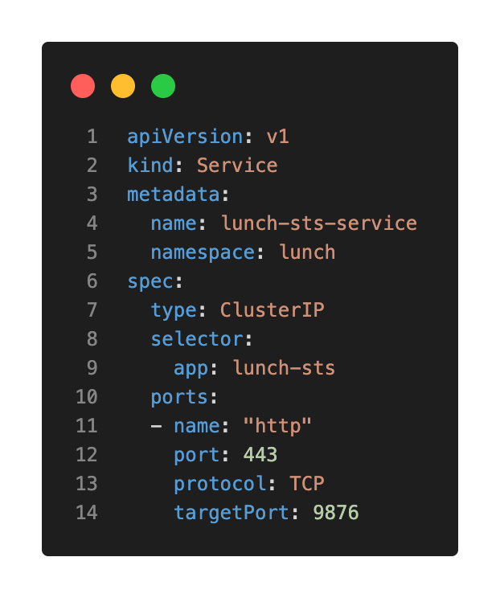
Workloads: StatefulSet (2/3)
“StatefulSets are valuable for applications that require one or more of the following.
Stable, unique network identifiers.
Stable, persistent storage.
Ordered, graceful deployment and scaling.
Ordered, automated rolling updates.” (Source)
StatefulSet Apps for data persistence (“Deployment+”)
Able to use:
volumeClaimTemplates
Ordinal "Stable-Network-ID" for Pods
Examples:
Databases
Tomcat with Light-Modules
…
Ensure correct Sizing of Storage Requests!

Slide 14
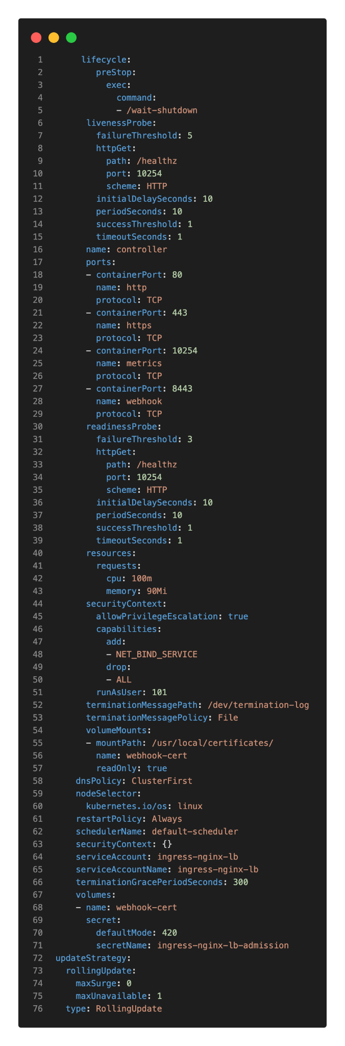
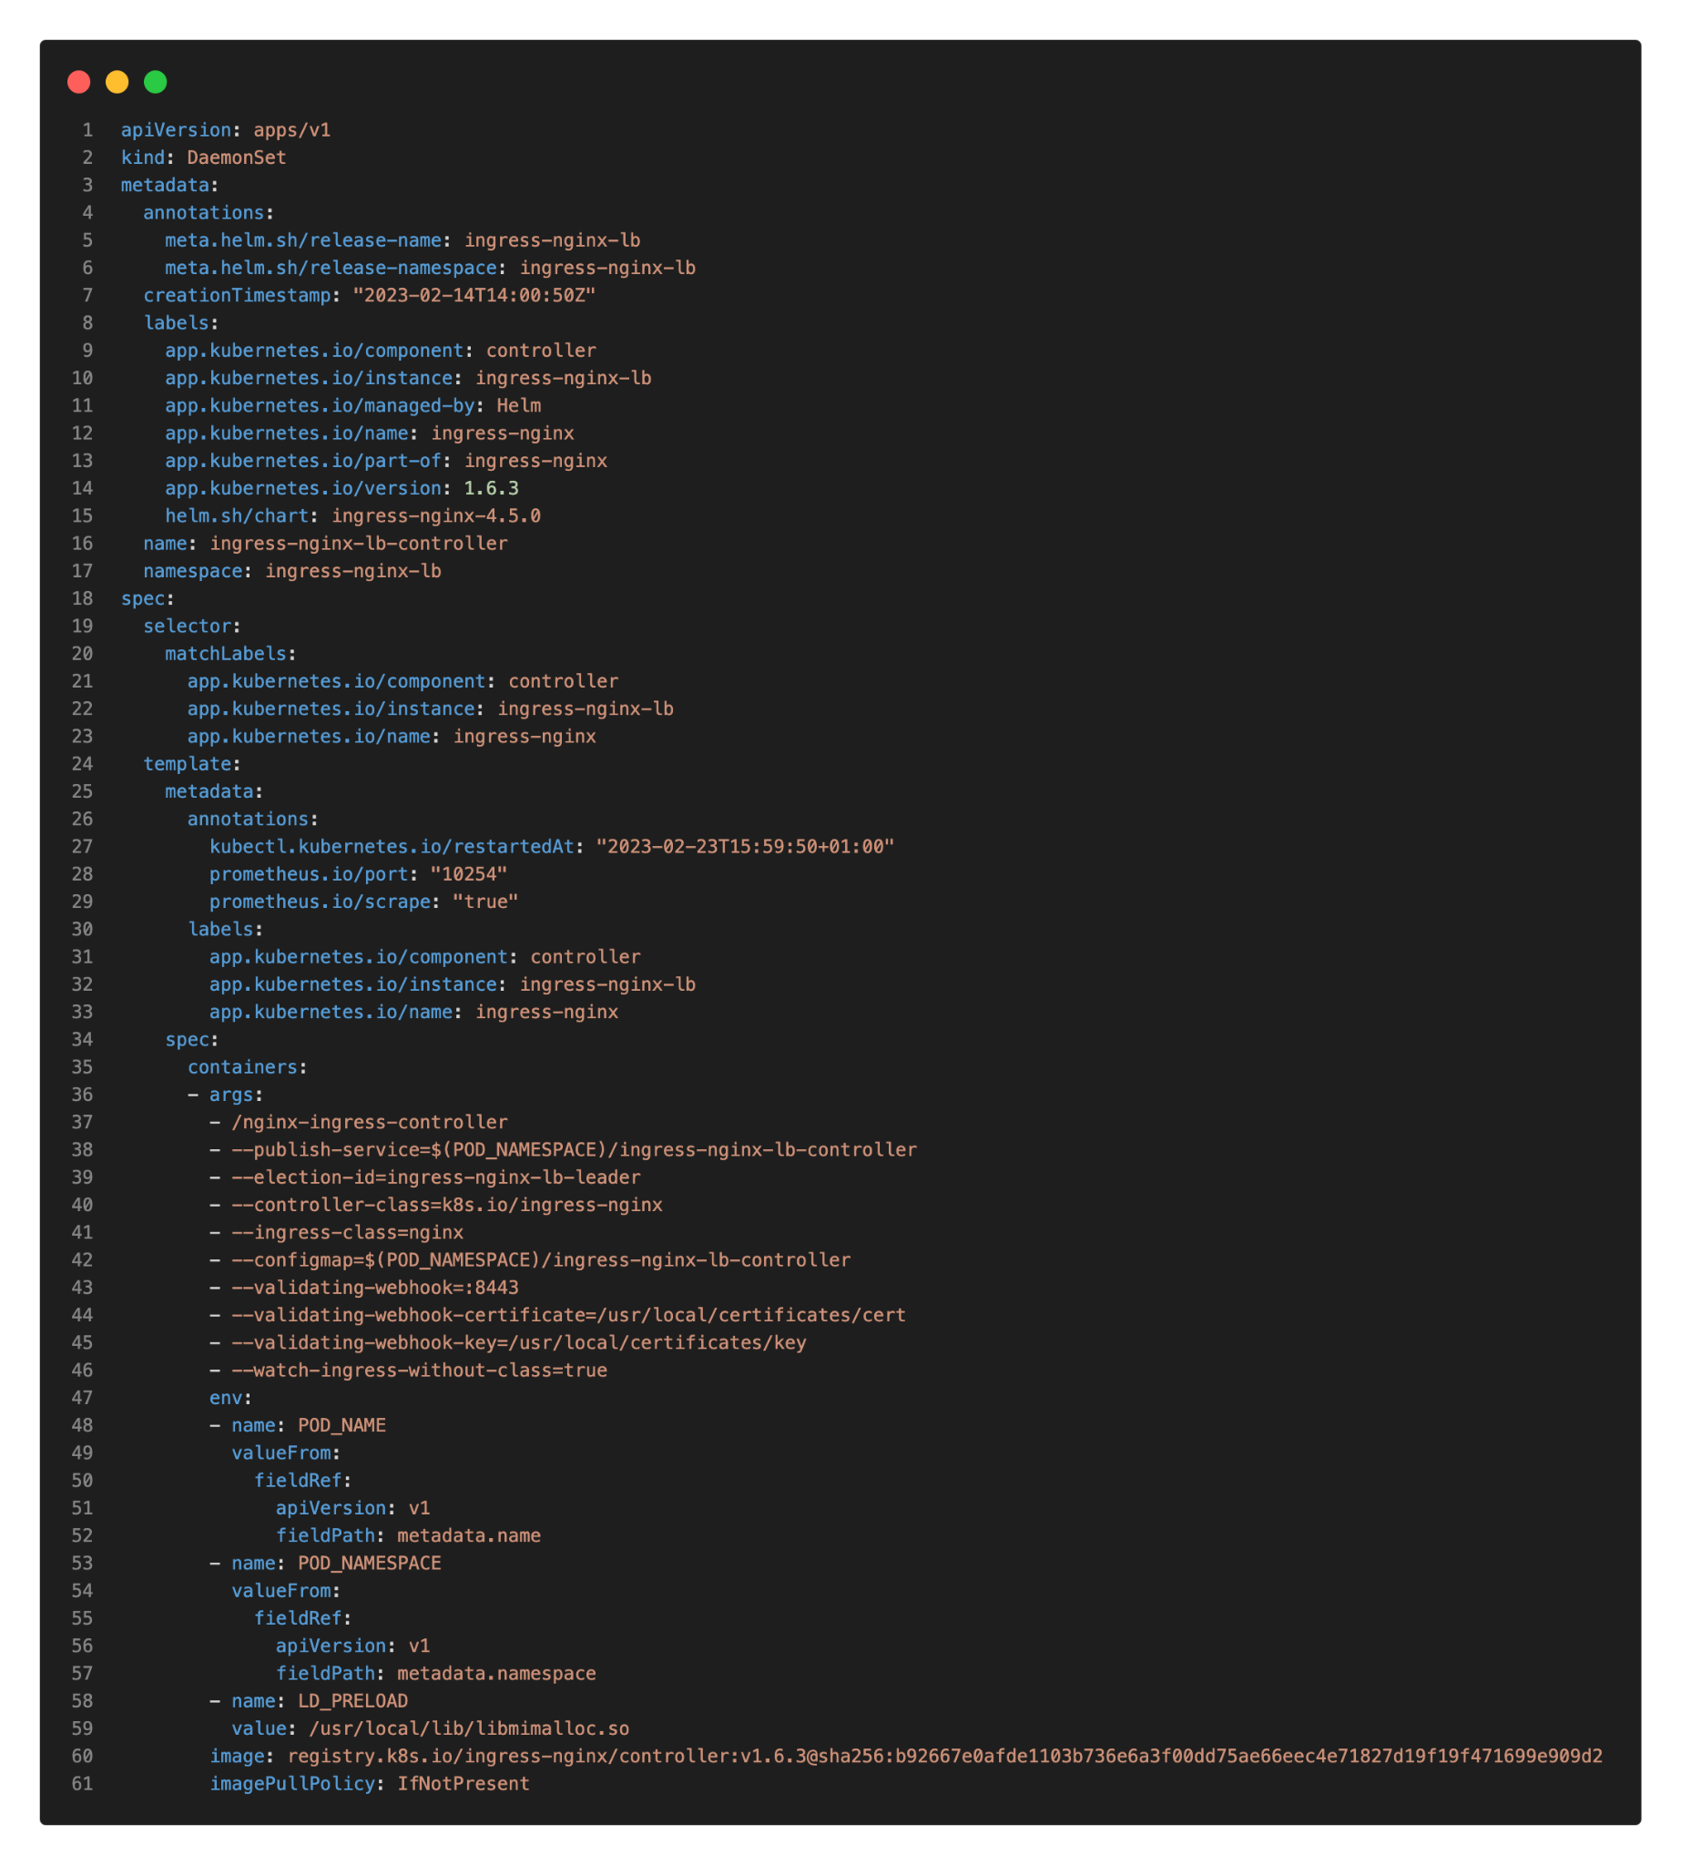
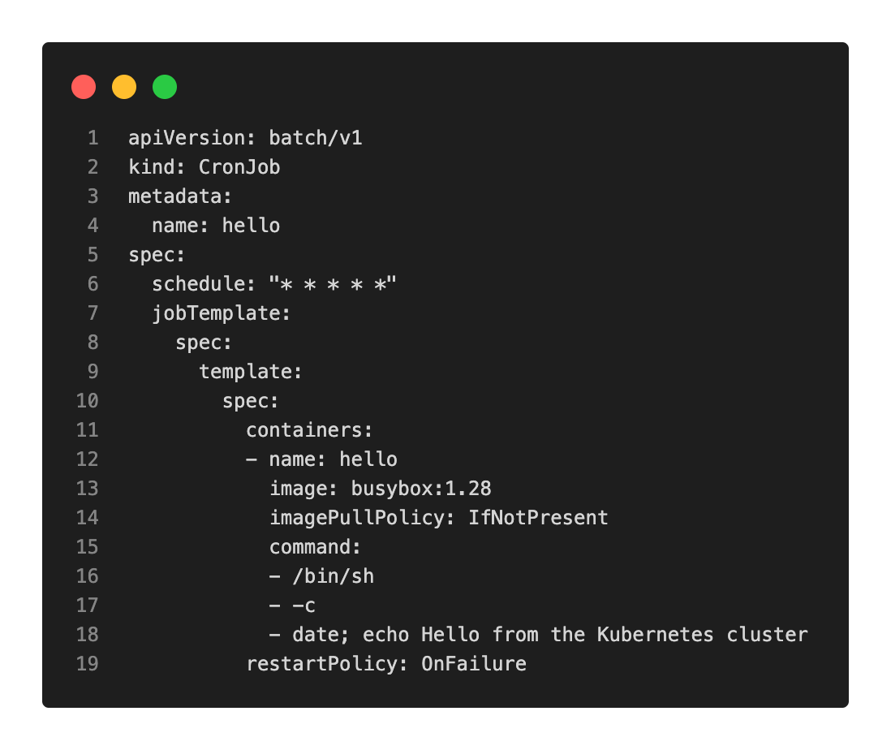
Workloads: DaemonSet, (Cron-)Job (3/3)
DaemonSet for single Pod on every Node
K8s Core Components (ie. kube-proxy)
Monitoring (Prometheus Node-Exporter)
Cloud Provider Services (ie. CSI Driver)
LoadBalancer (Ingress-Nginx Controller)
Job/CronJob
Single or scheduled Tasks
Triggered within the cluster
Common Scenarios:
CleanUp
Backups or Synchronization
Webhooks
Notes:
k get daemonsets.apps -n ingress-nginx-lb ingress-nginx-lb-controller -o yaml

Slide 15
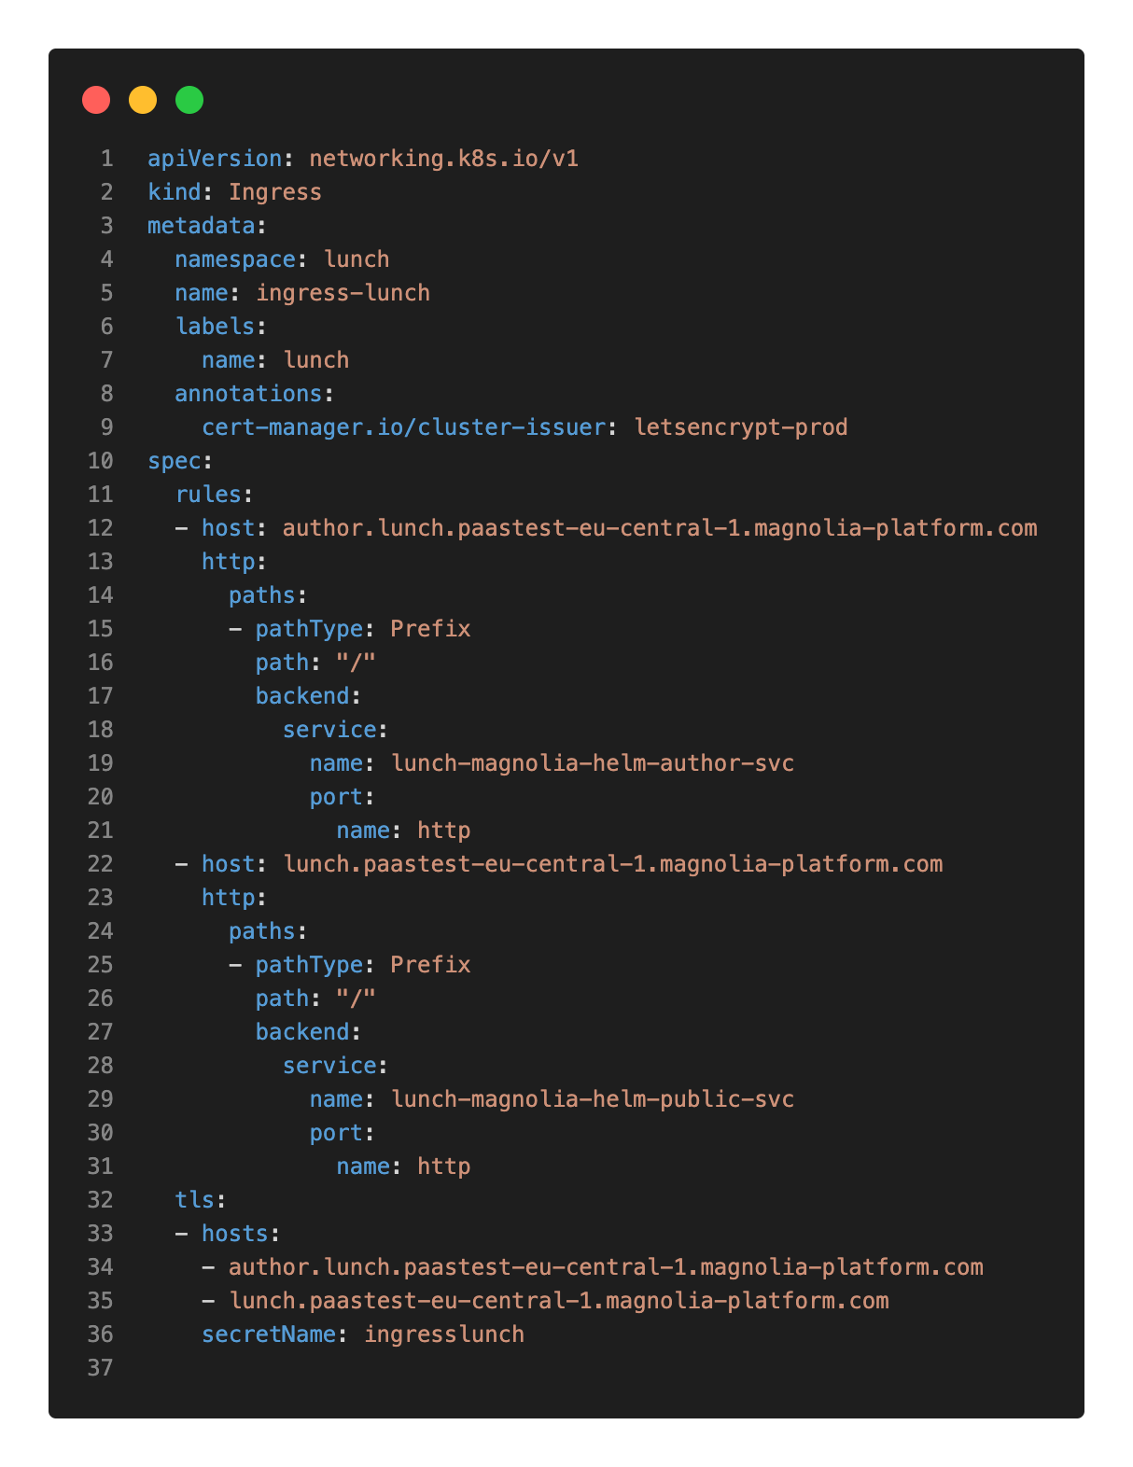
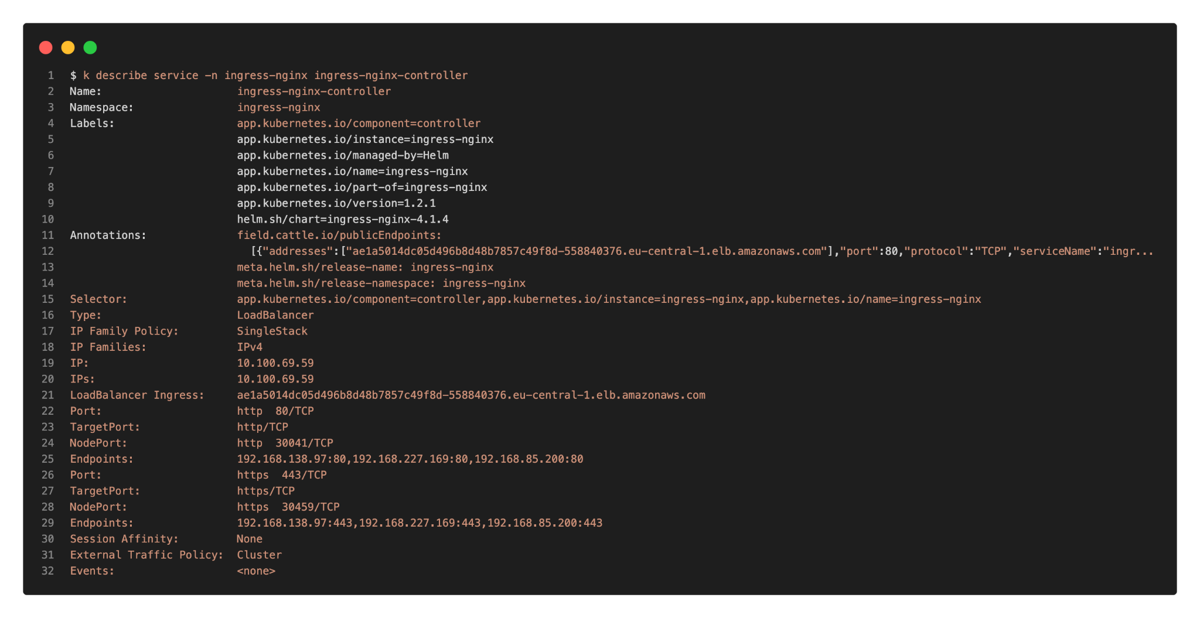
Ingress
Expose (Web) Services outside Cluster
Default Solution: Ingress-Nginx Controller
Service Type “LoadBalancer”
Routes to other Services inside
Single Entry Point for Web Services
Automatic configuration on CloudProvider LB

Slide 16
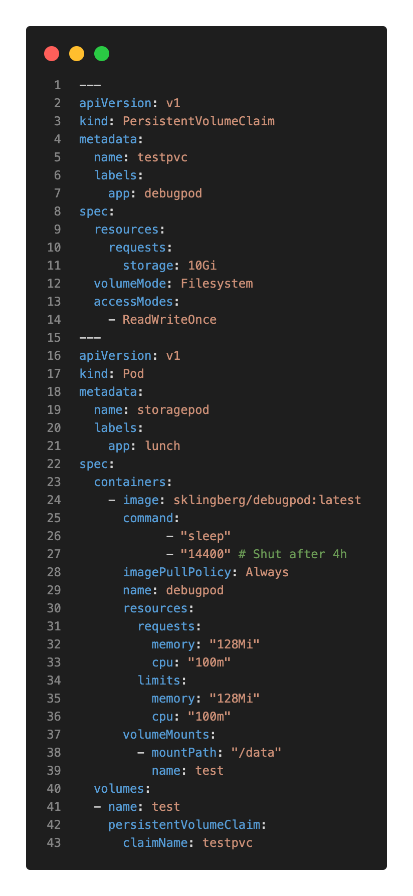
PV/PVC
All local data in K8s is considered ephemeral
…dies with the Pod (emptyDir)
… local (persistent) volume relies on node
Pods can claim a PersistentVolume(PV) with PersistentVolumeClaim(PVC)
AccessModes
ReadWriteOnce vs ReadWriteMany
Dynamic PV creation handled with a StorageClasses and a Container-Storage-Interface (CSI) Driver
Volume Mounts bound to Availability Zone!

Slide 17
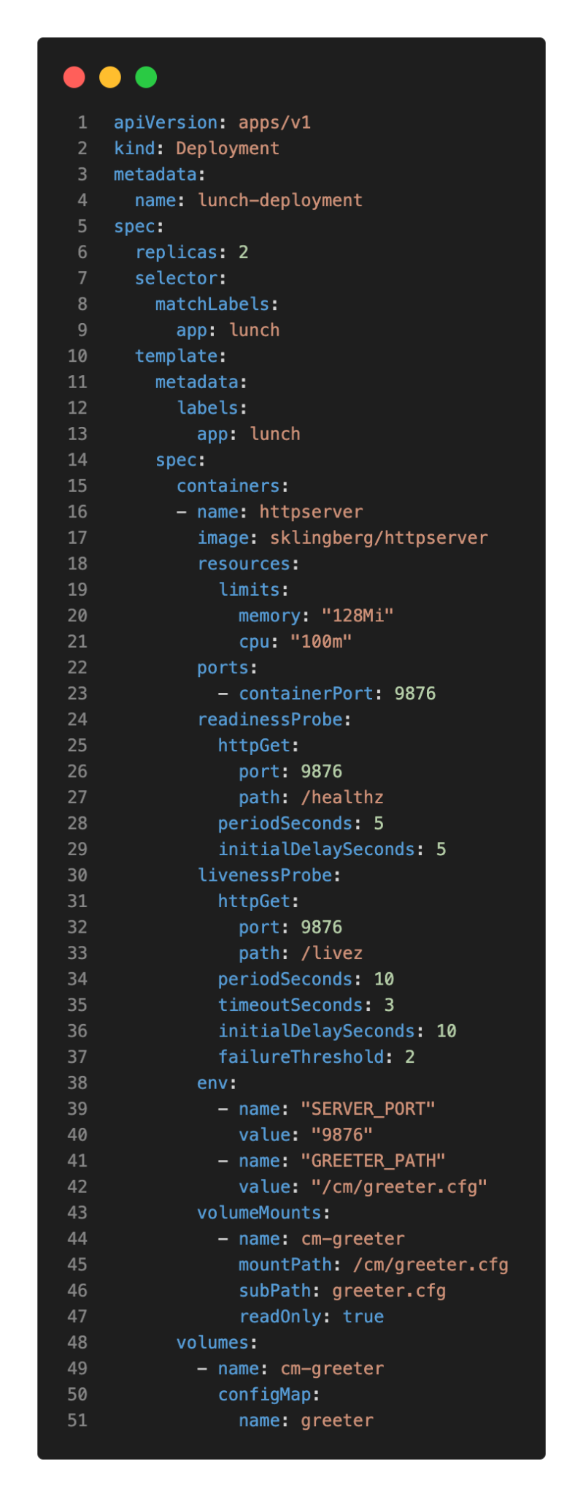
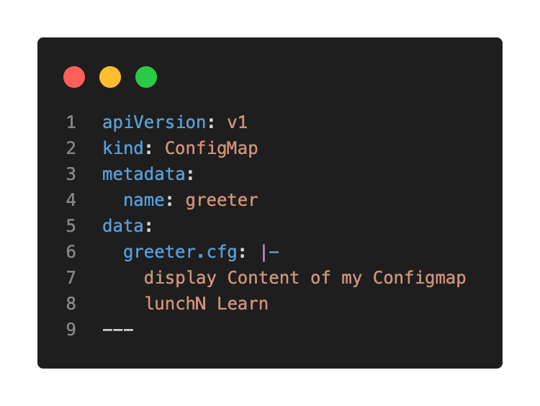
ConfigMap
ConfigMaps are the place to store dynamic instructions for a Pod, such as configurations
Example: Tomcat Config, JVM Arguments

Slide 18
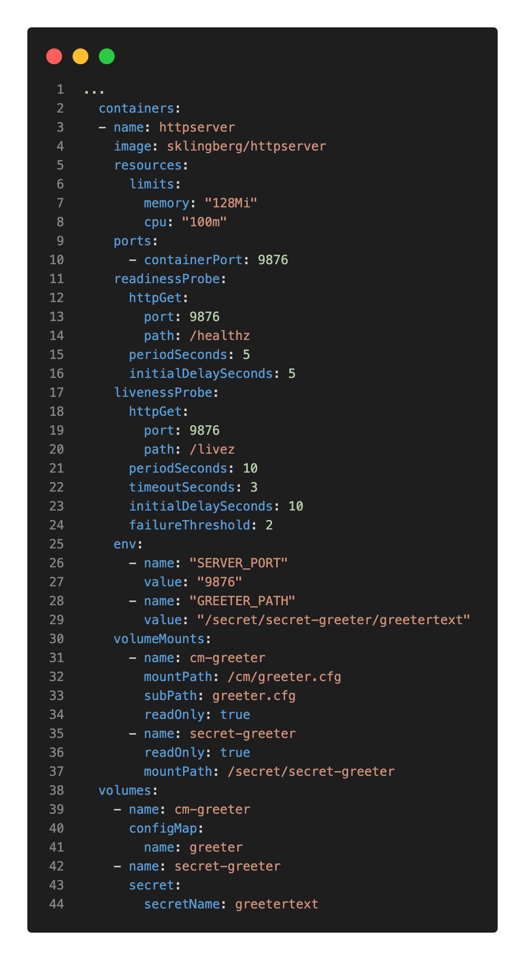
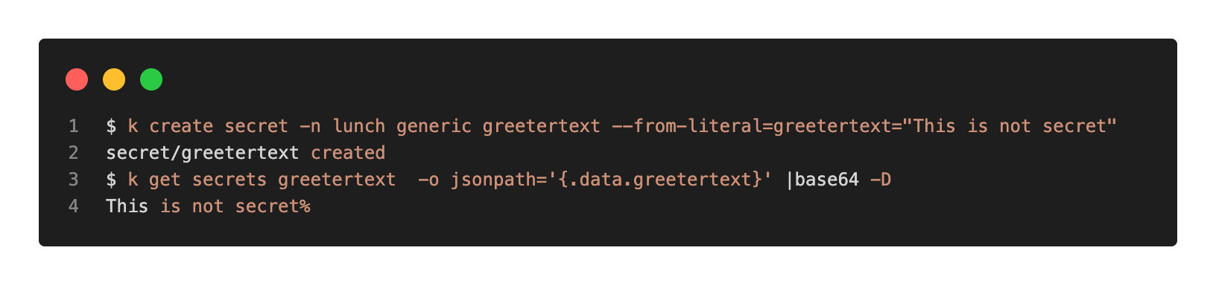
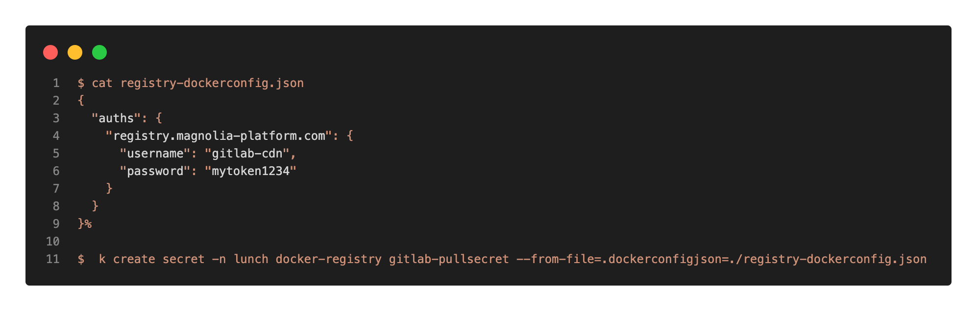
Secrets
Secrets are - despite the name - not secret!
Base64 encoded
Examples:
Tokens as ImagePullSecrets
ActivationKeypair for Magnolia Publishing

Slide 19
Demo: Bring Magnolia to K8s
Notes:
# Build Magnolia locally
## Cloud Archetype
~/Documents/git/magnolia-base/mgnltest/temp
# Generate
mvn archetype:generate \
-DarchetypeGroupId=info.magnolia.maven.archetypes \
-DarchetypeArtifactId=magnolia-dx-core-custom-cloud-archetype \
-DarchetypeVersion=1.6
Define value for property 'magnolia-bundle-version': 6.2.29
Define value for property 'shortname': lunch
Define value for property 'region': eu-central-1
Define value for property 'groupId': info.magnolia.cloud
Define value for property 'artifactId': lunch
Define value for property 'version' 1.0-SNAPSHOT: :
Define value for property 'package' info.magnolia.cloud: :
Define value for property 'project-name' lunch: :
Confirm properties configuration:
magnolia-bundle-version: 6.2.29
shortname: lunch
region: eu-central-1
groupId: info.magnolia.cloud
artifactId: lunch
version: 1.0-SNAPSHOT
package: info.magnolia.cloud
project-name: lunch
# Build
mvn clean && mvn package
# check WAR & Dockerfile
$ file lunch-webapp/target/lunch-webapp-1.0-SNAPSHOT.war
$ cat lunch-webapp/Dockerfile
# Get magnolia webapp
FROM alpine:3.16 AS builder
WORKDIR /app
COPY target/lunch-webapp-*.war /app/webapp.war
WORKDIR /app/
RUN unzip webapp.war && \
rm -vf webapp.war
FROM busybox:latest AS final
COPY --from=builder /app/ /magnolia/
# Build DockerImage
cd ~/Documents/git/magnolia-base/mgnltest/temp/lunch/lunch-webapp
$ docker buildx build --no-cache --platform=linux/amd64,linux/arm64/v8,linux/arm/v7 -t sklingberg/lunch:1.0-SNAPSHOT --push .
# Prepare Namespace
$ k create ns lunch
$ k apply -f .
service/author-db created
statefulset.apps/author-db created
persistentvolumeclaim/home-author created
service/author-svc created
deployment.apps/author created
configmap/configmap-author created
configmap/configmap-public created
ingress.networking.k8s.io/ingress-lunch created
service/public-db created
statefulset.apps/public-db created
service/public-svc created
service/ingress-public-svc created
statefulset.apps/public created
# When Ready
$ k port-forward -n lunch author-547ff969b8-s8p92 -c magnolia 8080:8080
# Visit Ingress
$ k get ingress -n lunch ingress-lunch
NAME CLASS HOSTS ADDRESS PORTS AGE
ingress-lunch nginx lunch.paastest-eu-central-1.magnolia-platform.com ae1a5014dc05d496b8d48b7857c49f8d-558840376.eu-central-1.elb.amazonaws.com 80, 443 3m13s
CHN0108-2 (☸paastest-eu-central-1:default) ~/Documents/project/lunchNlearn/k8sdemo/lunch_magnolia λ
$ k describe ingress -n lunch ingress-lunch
Name: ingress-lunch
Labels: name=lunch
Namespace: lunch
Address: ae1a5014dc05d496b8d48b7857c49f8d-558840376.eu-central-1.elb.amazonaws.com
Ingress Class: nginx
Default backend: <default>
TLS:
ingresslunch terminates lunch.paastest-eu-central-1.magnolia-platform.com
Rules:
Host Path Backends
---- ---- --------
lunch.paastest-eu-central-1.magnolia-platform.com
/author author-svc:8080 ()
/ public-svc:8080 ()
Annotations: cert-manager.io/cluster-issuer: letsencrypt-prod
field.cattle.io/publicEndpoints:
[{"addresses":[""],"port":443,"protocol":"HTTPS","serviceName":"lunch:author-svc","ingressName":"lunch:ingress-lunch","hostname":"lunch.pa...
Events:
Type Reason Age From Message
---- ------ ---- ---- -------
Normal CreateCertificate 3m21s cert-manager Successfully created Certificate "ingresslunch"
Normal Sync 2m24s (x3 over 3m21s) nginx-ingress-controller Scheduled for sync
Normal Sync 2m24s (x3 over 3m21s) nginx-ingress-controller Scheduled for sync
Normal Sync 2m24s (x3 over 3m21s) nginx-ingress-controller Scheduled for sync
# Check Services
Create a "checkservices" pod in ns "lunch" and "default"
$ k apply -n lunch -f checkservicename.yaml
pod/checkservices unchanged
$ k apply -n default -f checkservicename.yaml
pod/checkservices created
$ k exec -it -n lunch checkservices -- cat /etc/resolv.conf
nameserver 10.100.0.10
search lunch.svc.cluster.local svc.cluster.local cluster.local eu-central-1.compute.internal
options ndots:5
$ k exec -it checkservices -- cat /etc/resolv.conf
nameserver 10.100.0.10
search default.svc.cluster.local svc.cluster.local cluster.local eu-central-1.compute.internal
options ndots:5
$ k exec -it -n lunch checkservices -- ping -c3 author-svc
PING author-svc (192.168.203.138): 56 data bytes
64 bytes from 192.168.203.138: seq=0 ttl=253 time=1.677 ms
64 bytes from 192.168.203.138: seq=1 ttl=253 time=0.335 ms
64 bytes from 192.168.203.138: seq=2 ttl=253 time=12.006 ms
--- author-svc ping statistics ---
3 packets transmitted, 3 packets received, 0% packet loss
round-trip min/avg/max = 0.335/4.672/12.006 ms
CHN0108-2 (☸paastest-eu-central-1:default) ~/Documents/project/lunchNlearn/k8sdemo/lunch_magnolia λ
$ k exec -it -n default checkservices -- ping -c3 author-svc
ping: bad address 'author-svc'
command terminated with exit code 1
CHN0108-2 (☸paastest-eu-central-1:default) ~/Documents/project/lunchNlearn/k8sdemo/lunch_magnolia λ
$ k exec -it -n default checkservices -- ping -c3 author-svc.lunch
PING author-svc.lunch (192.168.203.138): 56 data bytes
64 bytes from 192.168.203.138: seq=0 ttl=254 time=0.060 ms
64 bytes from 192.168.203.138: seq=1 ttl=254 time=0.093 ms
64 bytes from 192.168.203.138: seq=2 ttl=254 time=0.098 ms
--- author-svc.lunch ping statistics ---
3 packets transmitted, 3 packets received, 0% packet loss
round-trip min/avg/max = 0.060/0.083/0.098 ms

Slide 20
02
(Magnolia) Helm

Slide 21

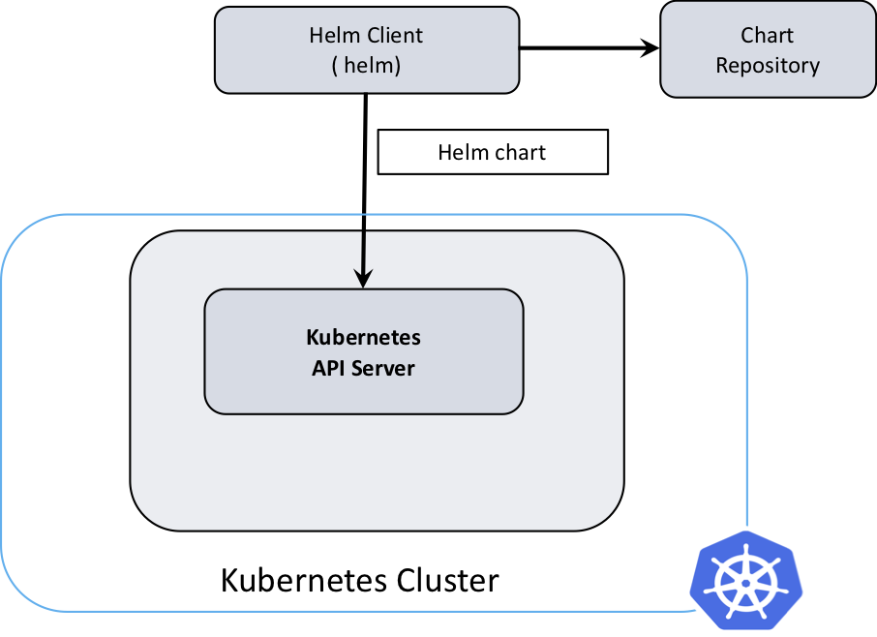
helm
Helm - The package manager for Kubernetes
“helps you manage Kubernetes applications — Helm Charts help you define, install, and upgrade even the most complex Kubernetes application.”
Helmv3 does “client only”
no more “Tiller” on Cluster required
Bundle K8s Application with Charts
Includes CustomResourceDefinitions(CRDs)
Chart-Repositories
Source

Slide 22
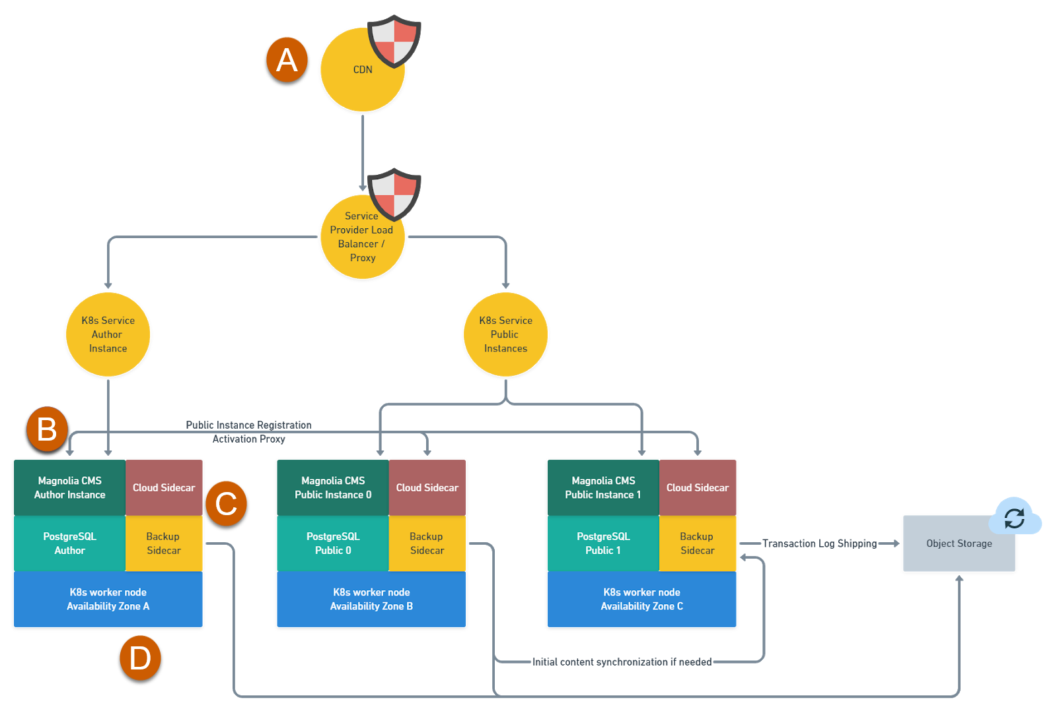
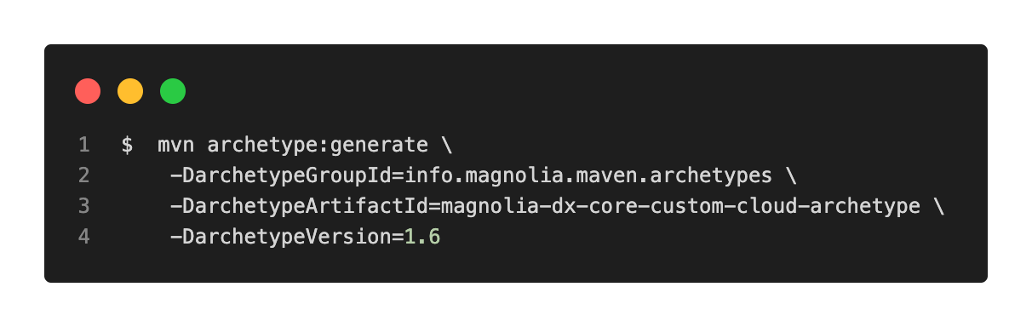
magnolia-helm
https://gitlab.com/mironet/magnolia-helm
Default values.yaml can be generated with Magnolia-Cloud-Archetype
Helm will manage all dependencies
Upgrade Magnolia-Helm
Source

Slide 23
Demo Basic Magnolia-Helm
Notes:
## Helm Basic Install
On Paastest
// KIND
// $ kind create cluster --name kindv21 --kubeconfig $HOME/.kube/kindv21.yml --config ~/k8s-cheatsheets/kind/kindv21_3n.yaml
// $ kind delete clusters kindv21
$ helm repo add mironet https://charts.mirohost.ch
$ helm search repo mironet/magnolia-helm --versions |head -n3
NAME CHART VERSION APP VERSION DESCRIPTION
mironet/magnolia-helm v1.7.0 6 A Helm chart for Magnolia CMS deployments
mironet/magnolia-helm v1.6.5 6 A Helm chart for Magnolia CMS deployments
# Check Values
$ helm show values mironet/magnolia-helm --version v1.7.0
# Install
$ helm upgrade --install --create-namespace -n lunch lunch mironet/magnolia-helm --version v1.7.0
# Create Missing Ingress
$ k apply -n lunch -f ingress_lunch.yaml -
## Cloud Archetype
~/Documents/git/magnolia-base/mgnltest
mvn archetype:generate \
-DarchetypeGroupId=info.magnolia.maven.archetypes \
-DarchetypeArtifactId=magnolia-dx-core-custom-cloud-archetype \
-DarchetypeVersion=1.6
Define value for property 'magnolia-bundle-version': 6.2.29
Define value for property 'shortname': lunch
Define value for property 'region': eu-central-1
Define value for property 'groupId': info.magnolia.cloud
Define value for property 'artifactId': lunch
Define value for property 'version' 1.0-SNAPSHOT: :
Define value for property 'package' info.magnolia.cloud: :
Define value for property 'project-name' lunch: :
Confirm properties configuration:
magnolia-bundle-version: 6.2.29
shortname: lunch
region: eu-central-1
groupId: info.magnolia.cloud
artifactId: lunch
version: 1.0-SNAPSHOT
package: info.magnolia.cloud
project-name: lunch

Slide 24
03
Operator in Kubernetes

Slide 25
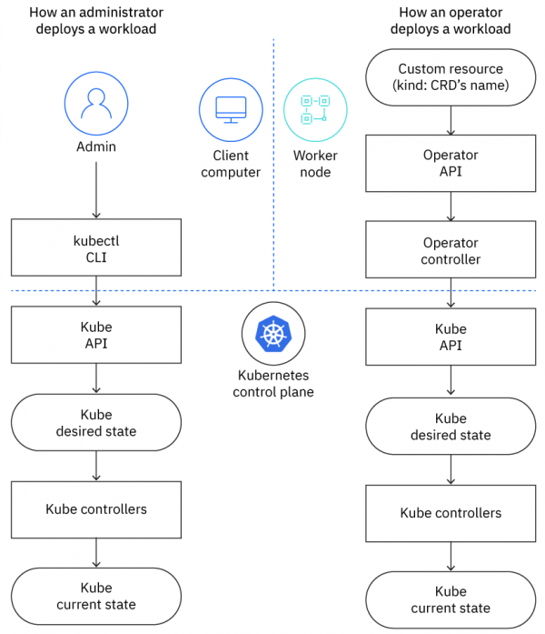
Operator
“A Kubernetes operator is an application-specific controller that extends the functionality of the Kubernetes API to create, configure, and manage instances of complex applications on behalf of a Kubernetes user.” (Source)
Use SDK Operator Frameworks for Boilerplate
Usually operate on CustomResourceDefinitions(CRDs)
Self-Defined, Custom K8s API Ressource
Stored in ETCD
Not necessarily limited to a Namespace
Authentication usually via ServiceAccount
Current Operators used in Magnolia
Ingress-Nginx
Cert-Manager
Prometheus Monitoring Stack
MT Operator
CDN, Domain/Certificate, Bootstrapping,
MetricsShipping, Operational Tasks, …
More Magnolia Operators about to come …
Source
Notes:
Check into Operator CRDs on paas

Slide 26
04
Magnolia PaaS

Slide 27
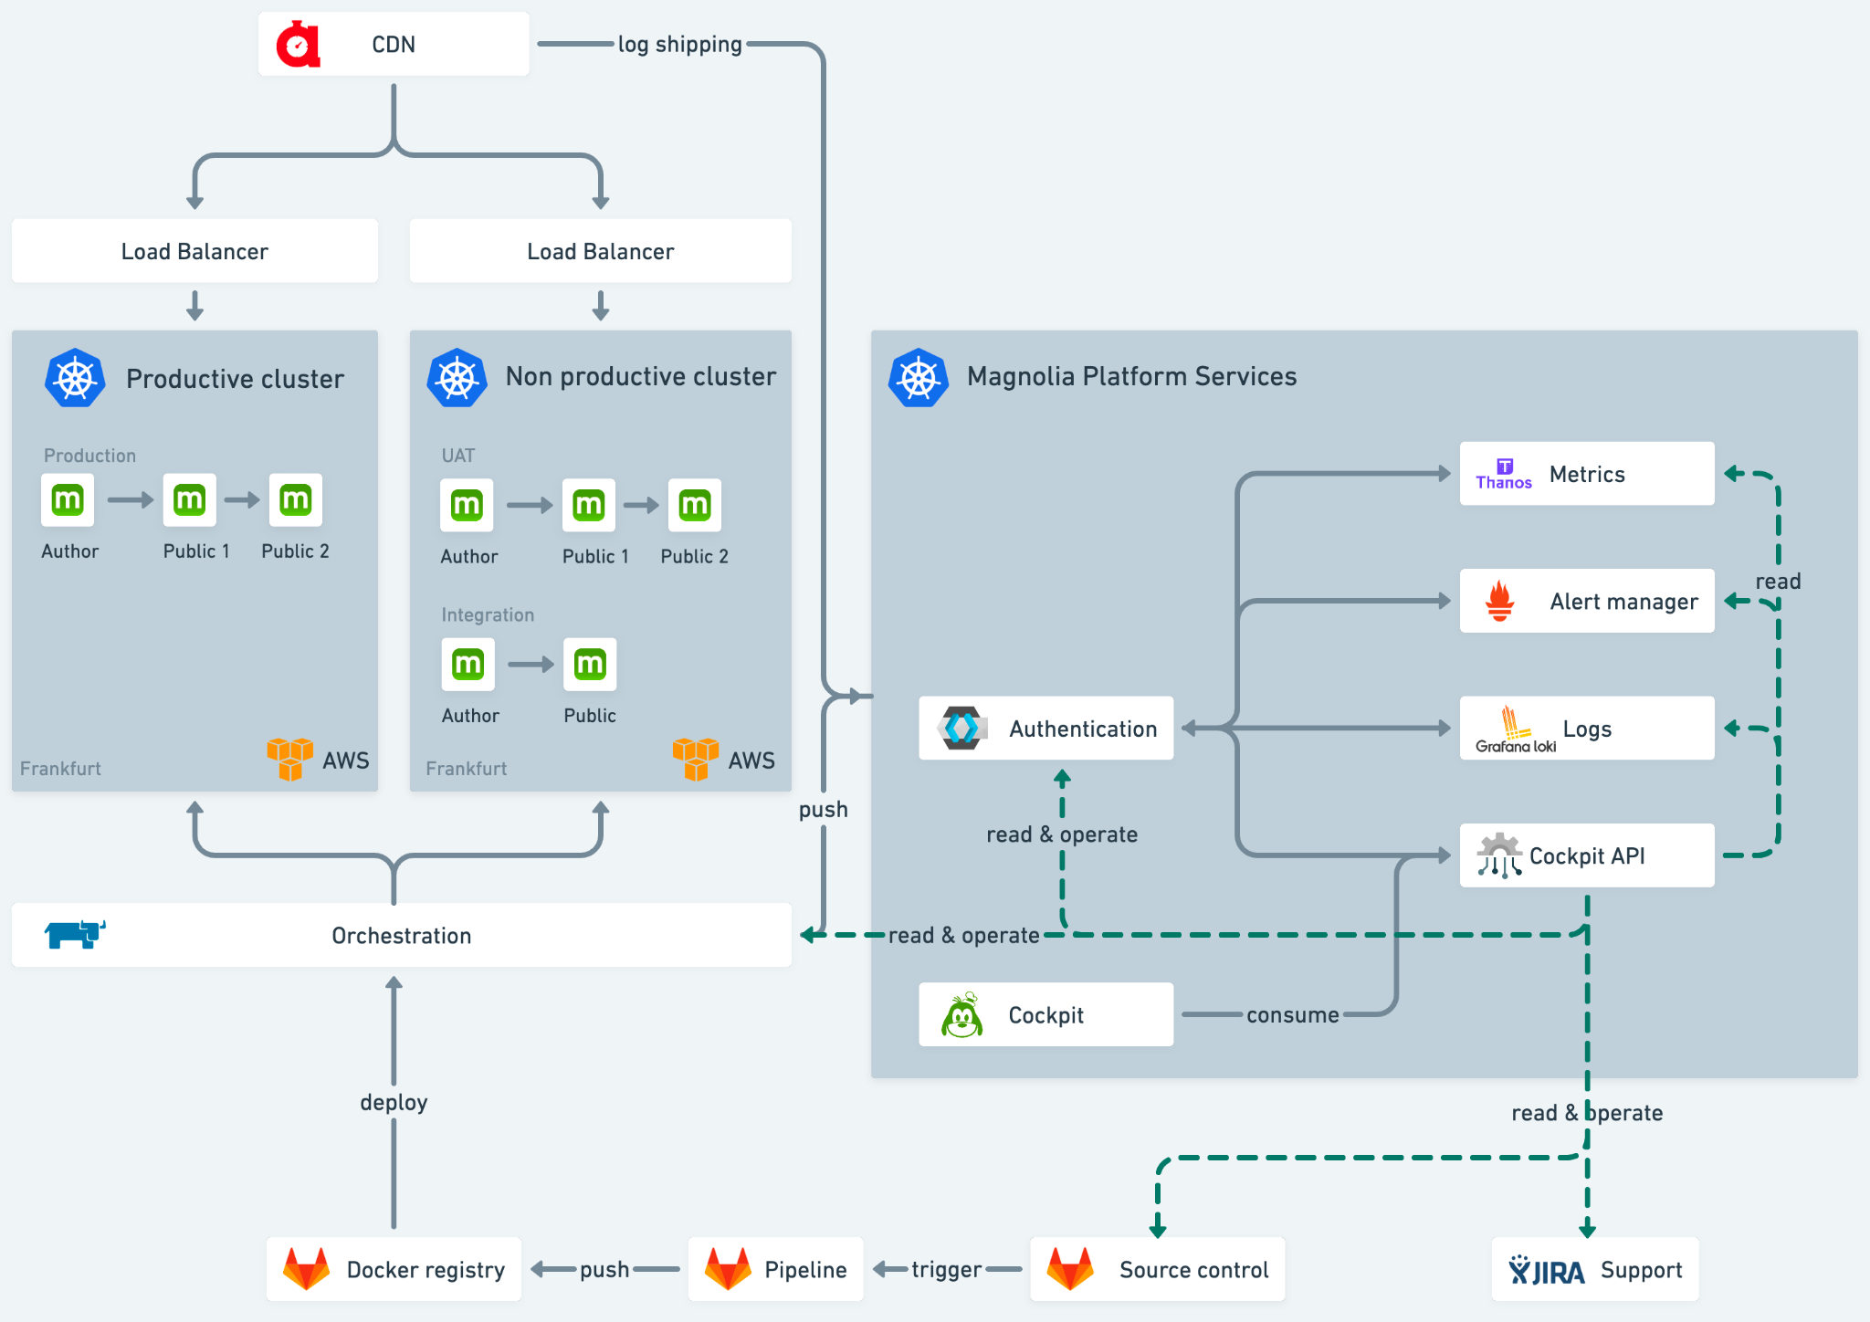
Magnolia PaaS
Cloud-Agnostic
Public / Author
Multiple Magnolia Instances
Webserver
+ Database
Prod/Dev Environments
Infrastructure
Cockpit, Monitoring, CDN, CI/CD Pipeline, Operator
Source

Slide 28
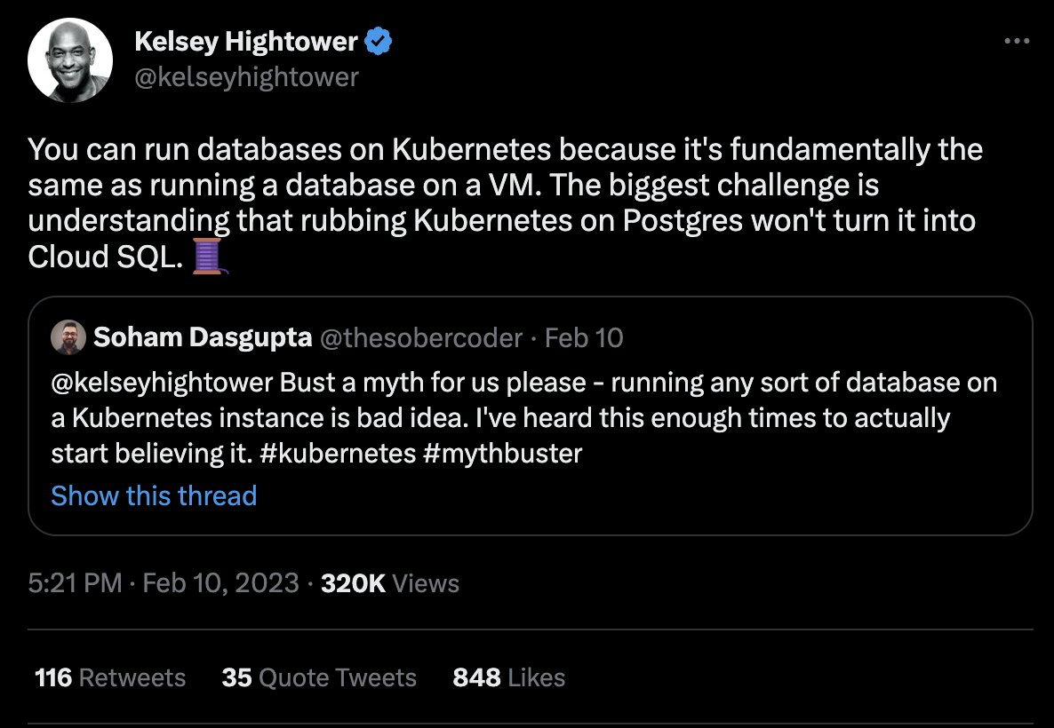
DBs on Kubernetes…
Source
Notes:
Very controversial and it’s true!
Operator (Zalando etc.)
Pros/Cons Local StatefulSet versus DB Service/Shared:
+ Cloud-agnostic
+ Easy to spin up
+ K8s-Native
+ Autonomous DB Instance
- No HA
- Resizing/Migration/Backup and Restore require more care (Single Instance, managed trough ie. Helm)
- Good Solutions out there with Operators; still Single Point of Failure (HA does not prevent misconfiguration)
+/- Scalability

Slide 29
05
Q & A

