Slide 1

PaaS Lunch & Learn Series
- Operations -
March 23, 2023
sebastian.klingberg@magnolia-cms.com

Slide 2
Table of contents
01
magnolia-backup
02
Volume Snapshots
Recover K8s Volume Snapshots
Application-based DB Backup in Magnolia PaaS
03
Disaster Recovery
04
Scaling
What to do, if a complete K8s Cluster becomes unavailable?
Scale Magnolia and Cluster Resources
05
Updates
How we update your Magnolia PaaS infrastructure
06
Q&A

Slide 3
01
magnolia-backup

Slide 4
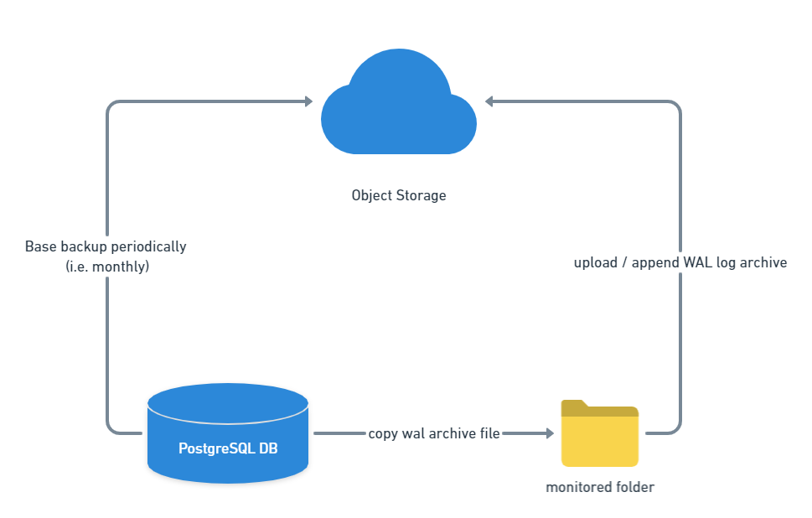
Automatic Backups
Use Postgres-native Tools for Backup and Restore
  Write-ahead-Logging (WAL)
magnolia-backup Sidecar in Public-/Author-DB Instance
  Configure via Helm values.yaml
Backup to Object Storage
  AWS S3
  GCS
  Azure Blob
  Proxy ObjectStorage via Minio
Use Storage Replication for DR
Source

Slide 5
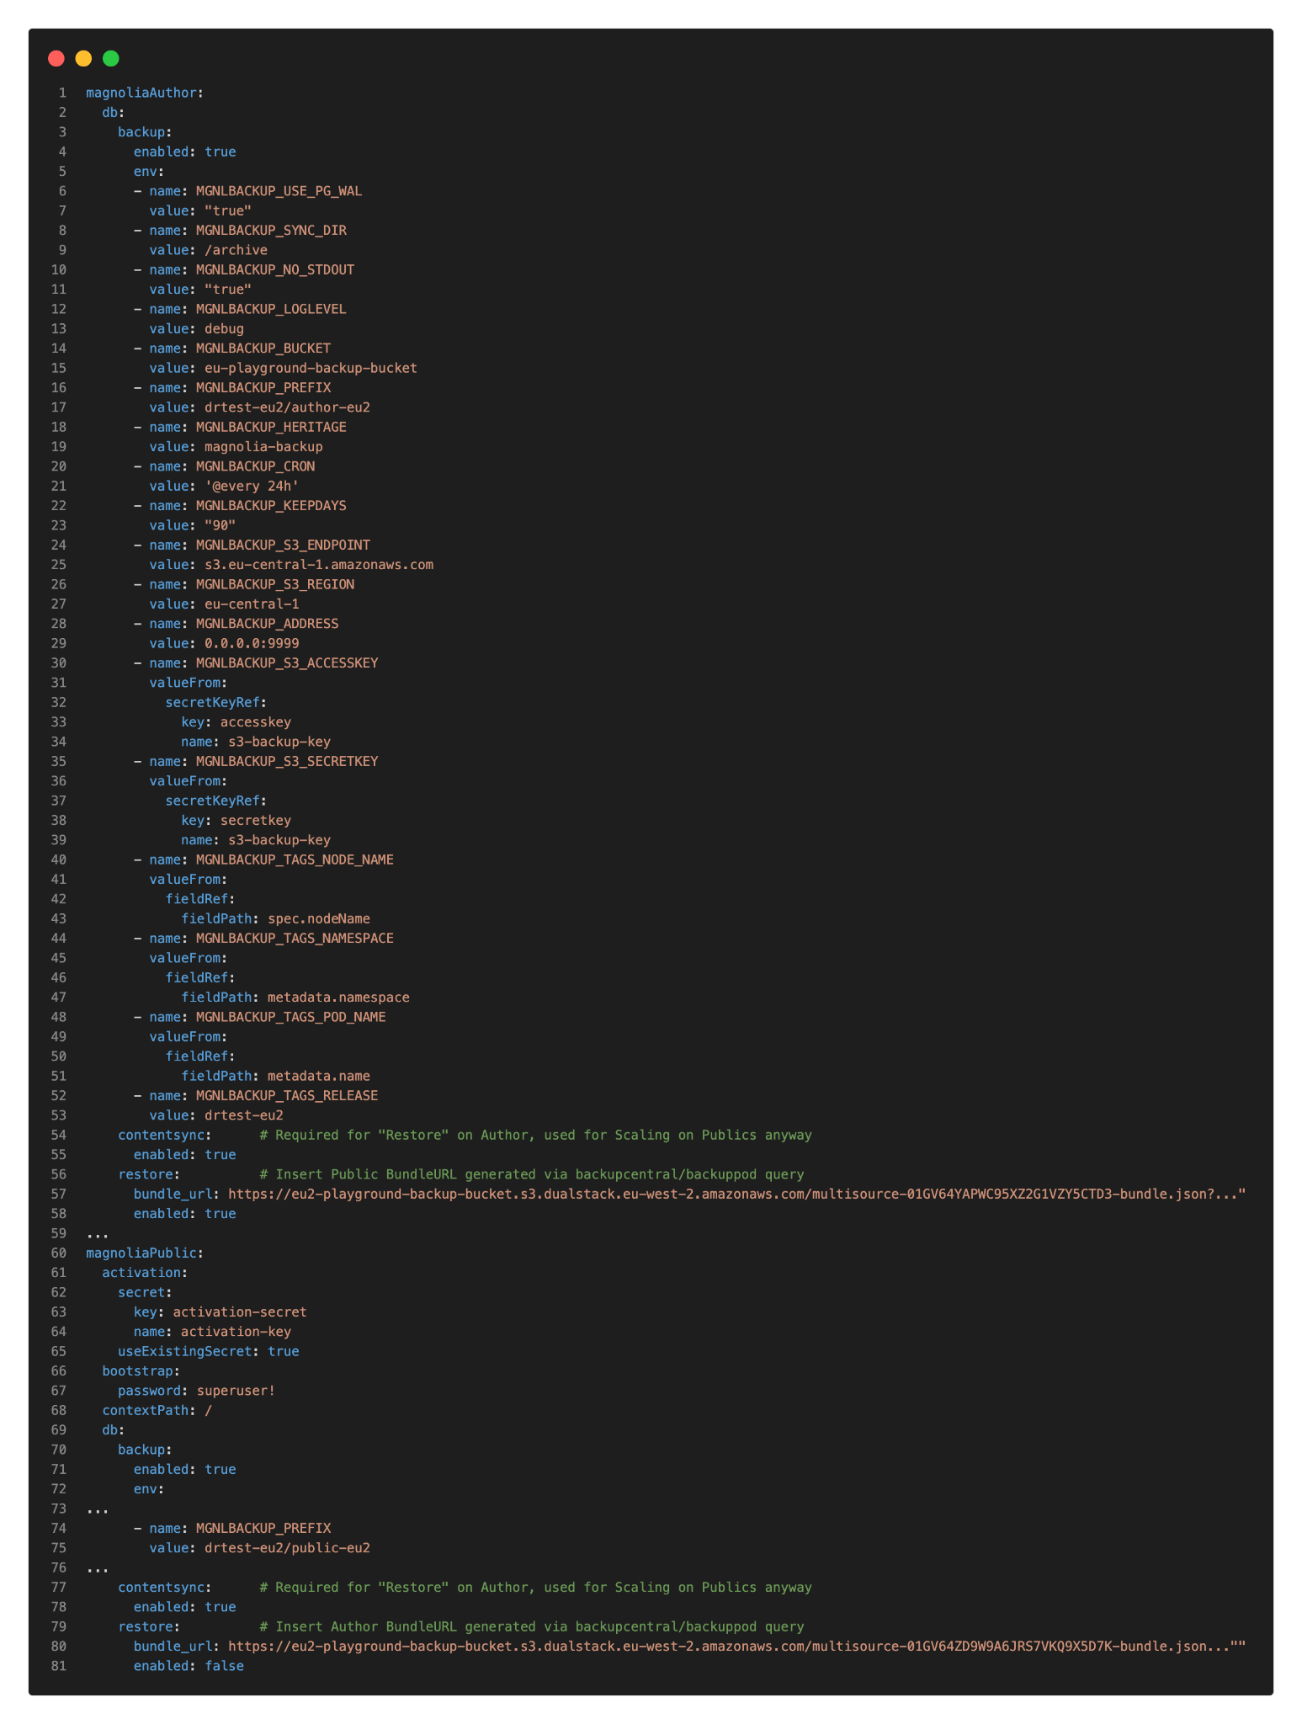
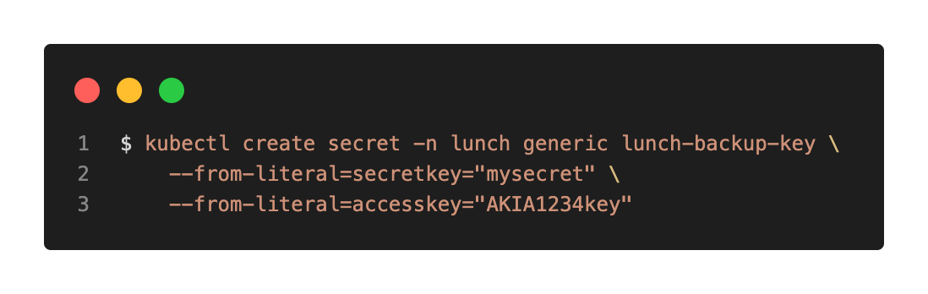
Setup Backup (Magnolia-Helm)
Create Object Storage
Create backup-key in Namespace
Modify Helm values.yaml of your Magnolia Environment
Optional (Recommended):
  Setup Replication Job to another Zone
  Setup BackupCentral Instance
    ReadOnly
    Multi-Bucket (-Region) capable!

Slide 6
Restore from Backup
Connect to Backupcentral in target cluster
Request presigned BundleURL Link from backupcentral (or backup Pod)
Modify Helm values.yaml and insert BundleURL links
  Ensure contentsync is enabled, even on the Autor
    magnoliaAuthor.db.contentsync.enabled = “true”
    magnoliaAuthor.db.restore.enabled = “true”
    magnoliaAuthor.db.restore.bundleUrl = “https://backup-bucket.s3.dualstack…”
Scale down Magnolia Webserver & Database Instances
Delete existing PVCs of Database Statefulset
Delete Indexes in Webserver Statefulset (Author & Public)
Helm Deploy including restore values (will restart Author/Public Webserver + DB Instances)
Observe Restart
  Contentsync Pod Logs & verify restore status
(Remove Restore Section from
Values.yaml, redeploy)
Notes:
Demo later

Slide 7
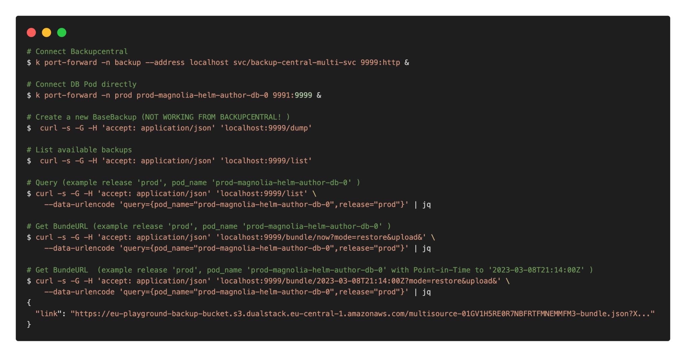
cURL cheatsheet magnolia-backup
Notes:
Demo later

Slide 8
02
Volume Snapshots

Slide 9
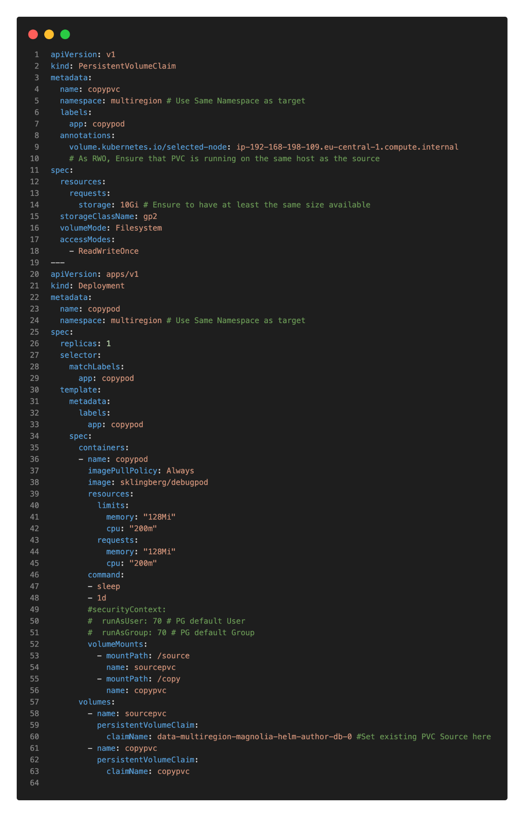
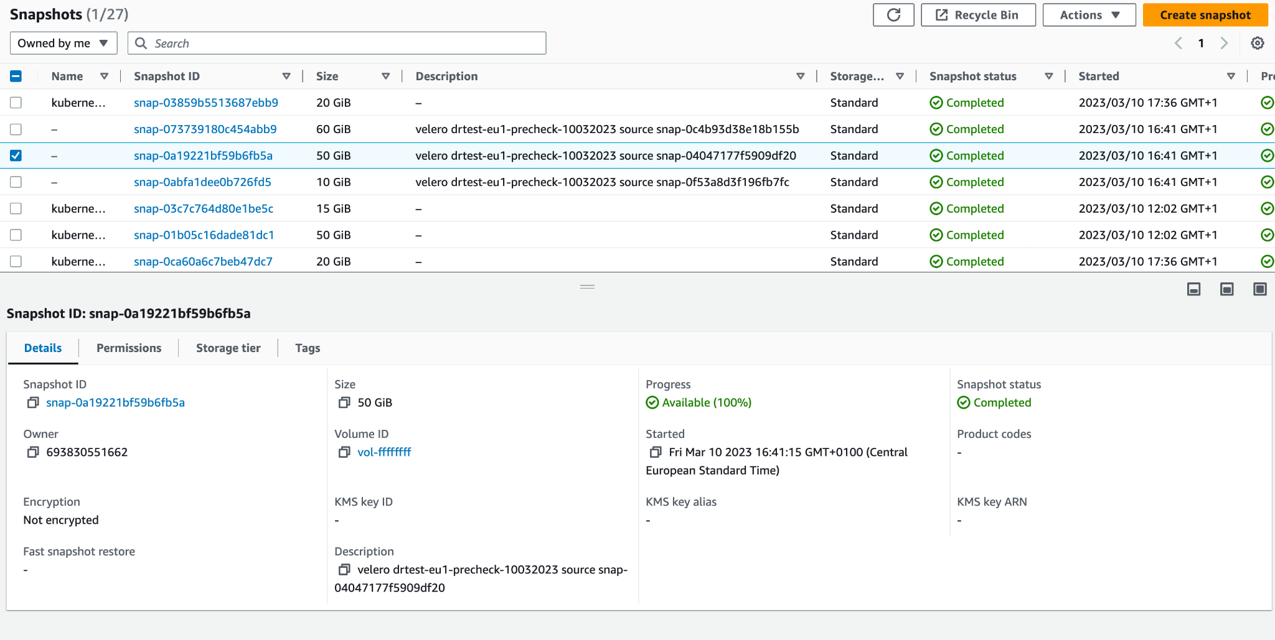
Volume Snapshots
Cloud-Provider allow volume-based Snapshots
  CSI-Driver created volumes included!
Use Volume Snapshots as additional backup layer to restore
Manual Copy/Restore can be quite time consuming and error-prune
Snapshot Managers like velero.io backup/restore
Notes:
Todo Demo

Slide 10
Demo Volume Migration StatefulSet Volume

Slide 11
Demo Snapshot-based Restore
/w Velero.io

Slide 12
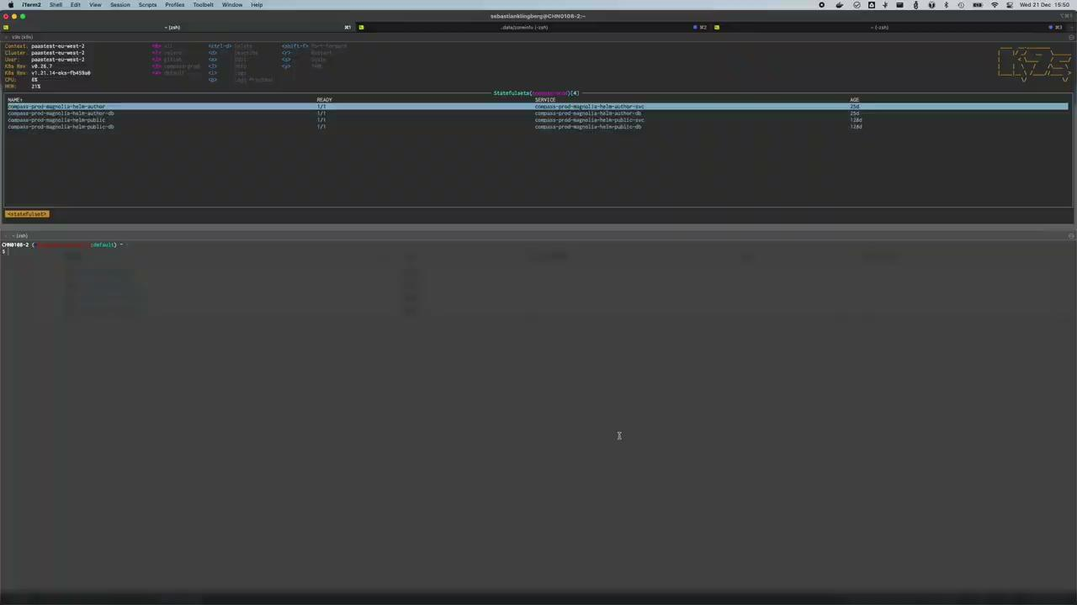
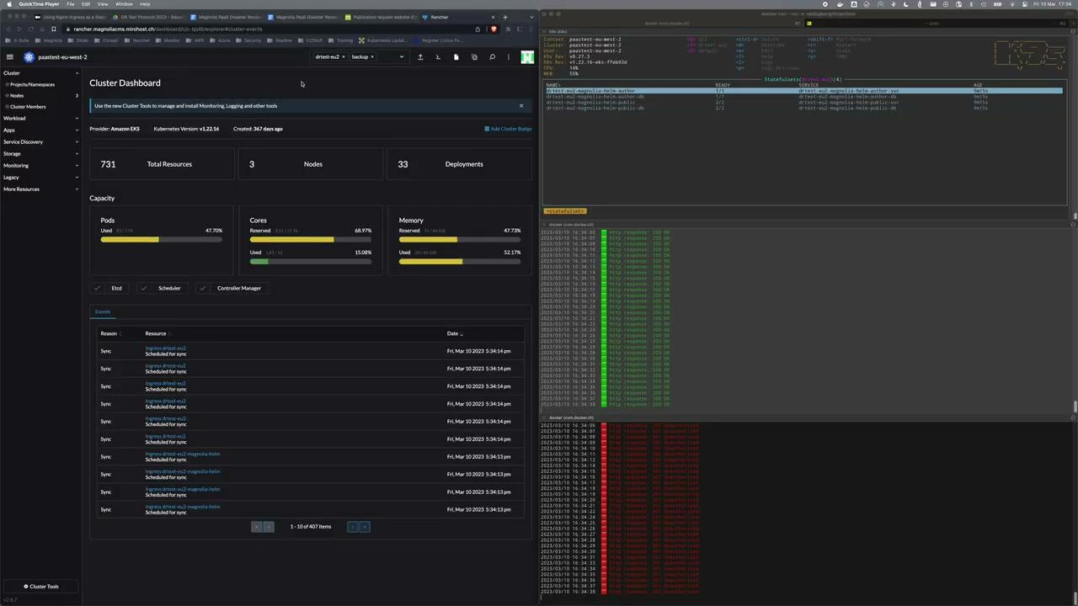
Demo Snapshot-based Restore
using Velero.io
Notes:
Observe Setup
Check Status Velero in Cluster
Check Testpage
(01:20) Create and check Snapshot Backup
Usually done scheduled via CronJob
Target same Zone as Cluster
(02:58) Delete Namespace and all K8s Components
Delete Workloads and all Volumes
CompleteDowntime
(04:20) Create Restore Job and submit
Restore all components from Backup in namespace “drtest-eu2”
Including cloud-based Volume snapshots
(06:20) Public and Authoris serving again!
~3:20min until recovery
(06:50) Publishing Test
(07:57) Publishing successful

Slide 13
03
Disaster Recovery

Slide 14
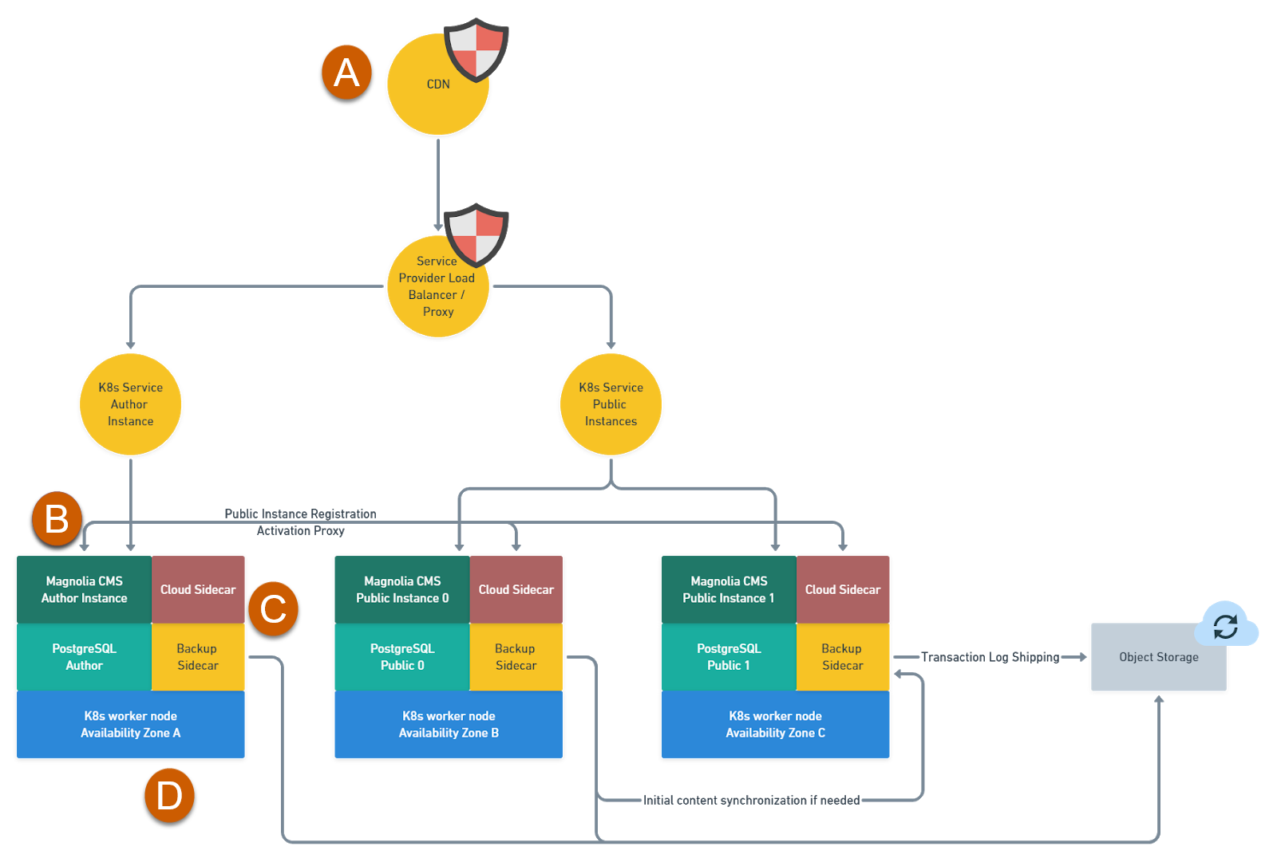
Disaster Recovery - Scenarios (lowest to highest impact)
Loss of Magnolia Instance
  One Public (One or all)
  Author
Loss of a single Availability Zone
  Public
  Author
Loss of multiple Availability Zones
  Public (one or all)
  Author
Loss of a Region
  All Instances
Even considering high SLA with Cloud Provider and quickly bringing back services:
Potential Data-loss and Integrity need attention!
Source

Slide 15
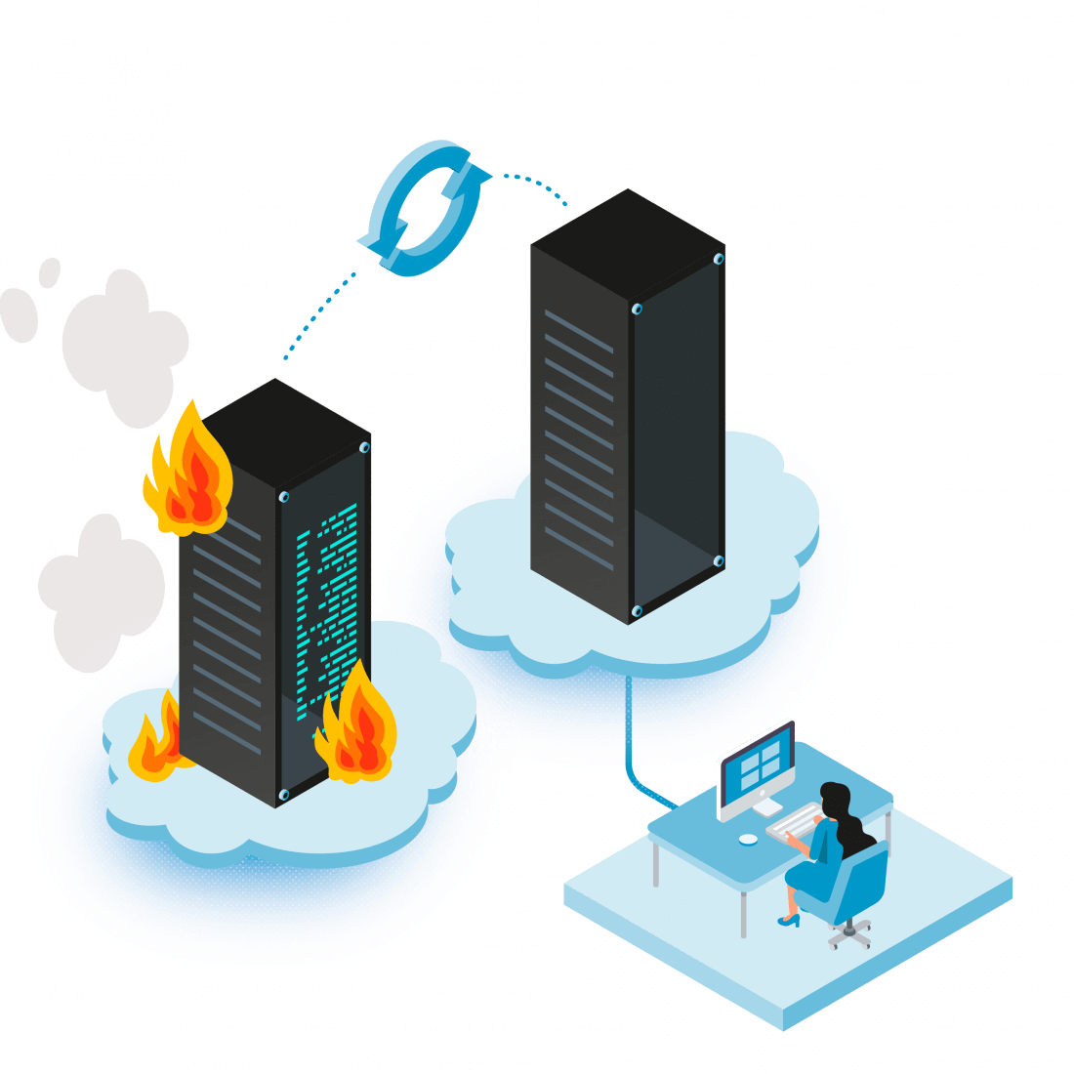
Disaster Recovery - How to recover?
Disaster Recovery Sources
  Application-based Backup
  Snapshot-based Backup
Attention! Backup Storage location
  S3 within the same region may fast, but likely affected on an outage too!
Spare Cluster resources need to be created and prepared
Ensure DNS Control!
Source

Slide 16
Demo Disaster Recovery
/w magnolia-backup

Slide 17
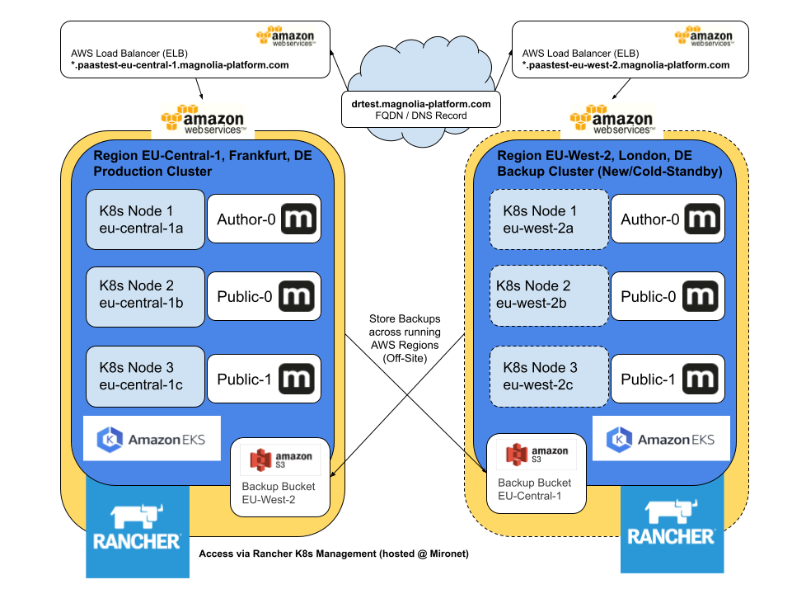
Setup Disaster Recovery

Slide 18
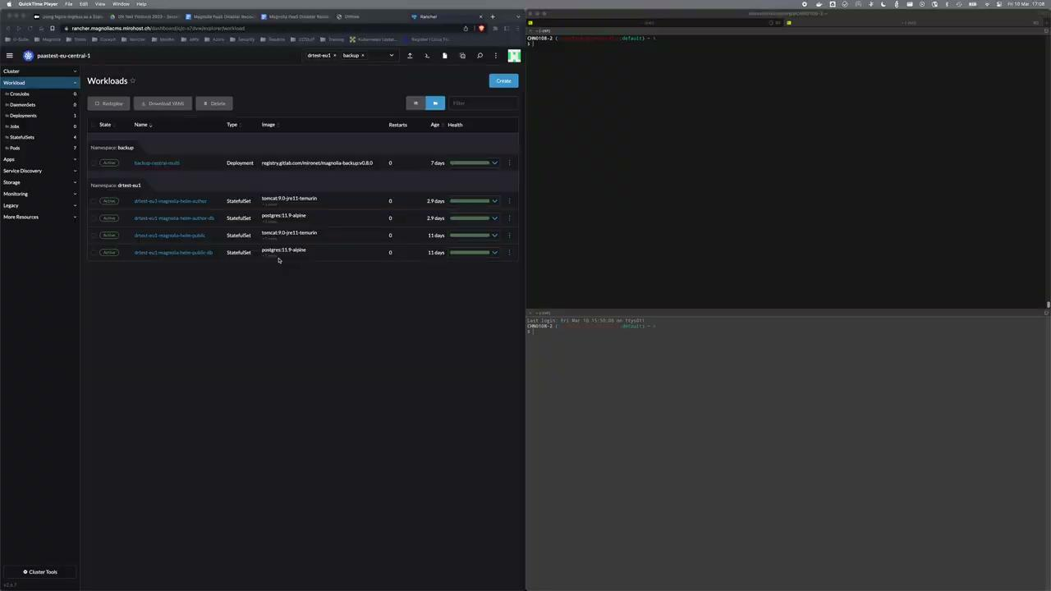
Demo Disaster Recovery
Restore Magnolia Instance in (cold-standby) K8s Cluster using magnolia-backup
Notes:
(02:55) Show differences values.yaml
Source: paastest-eu-central-1
Recovery Target: paastest-eu-west-2
(04:24) Drain and Cordon Node in eu-central-1b
Delete Workloads and all Volumes
CompleteDowntime !
(05:10) Check Target Cluster and components
(07:30)Connect to BackupCentral in TagetCluster
(08:10) Query BackupCentral for RestoreBundle Author-0 and Public-0, lately running and “broken” in paastest-eu-central-1
(09:40) Modify “values.yaml” for eu2
(10:23) Commit and observe Build Pipeline
(13:30) Meanwhile change DNS entry of “drtest.magnolia-platform.com” to point to LB in recovery cluster
(15:20) Trigger Pipeline in Recovery Cluster
Uninstall PVCs from previous tests and run pipeline again
(17:00) Retrigger Pipeline and observe
(17:40) Check Author-0 DB restoring Bundle of broken Cluster
(18:30) check Public-0 restoring too
(20:40) Author is ready, but only responding on cluster ingress
(22:35) Applying Ingress to “drtest-eu2” restored namespace
(22:36) Publics and Author available
~8min until recovery (with fixing Ingress)
(23:35) Verify Content and receivers
(24:00) Test Publication
(25:06) Publication successful on Publics!

Slide 19
04
Scaling

Slide 20
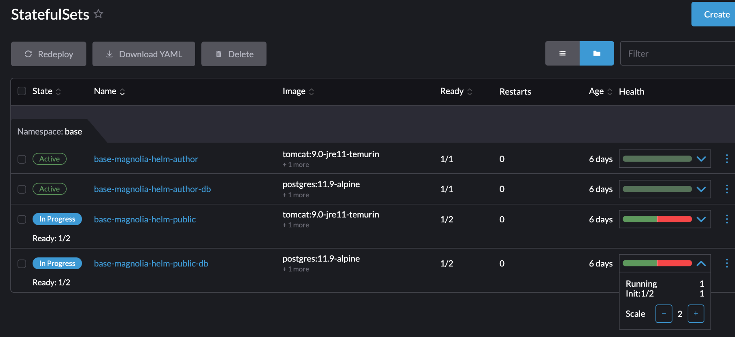
Scaling
Scaling up cloud-managed K8s nodes is fairly easy and included in the concept
But how about the Magnolia Workload?
  Single Magnolia Author Instance
  Multiple Magnolia Public Instances
    Dynamic Scaling
    Contentsync and Bootstrapper!
… no automated vertical/horizontal workload or node scaling today (metric-based)
Notes:
Automated scaling:
Despite technically possible; we don’t do it today. Sounds easy but you’ll need to carefully tweak this and it’s also a contractual question

Slide 21
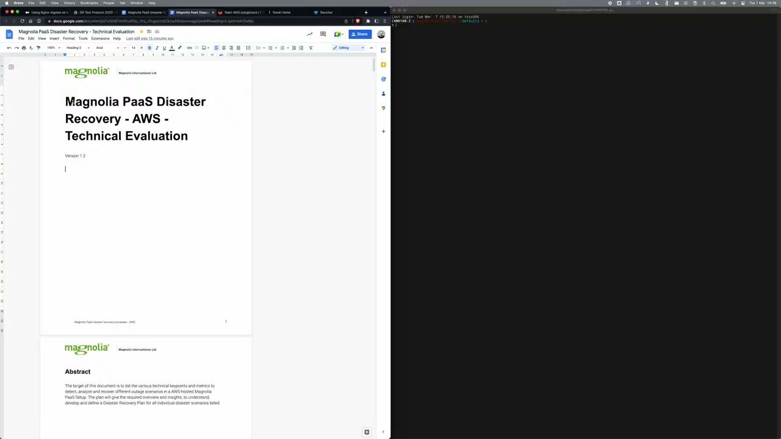
Demo Contentsync
using magnolia-backup
Notes:
Jump to 30:00 until Public-1 is being recreated
31:40 to check content

Slide 22
05
Updates

Slide 23
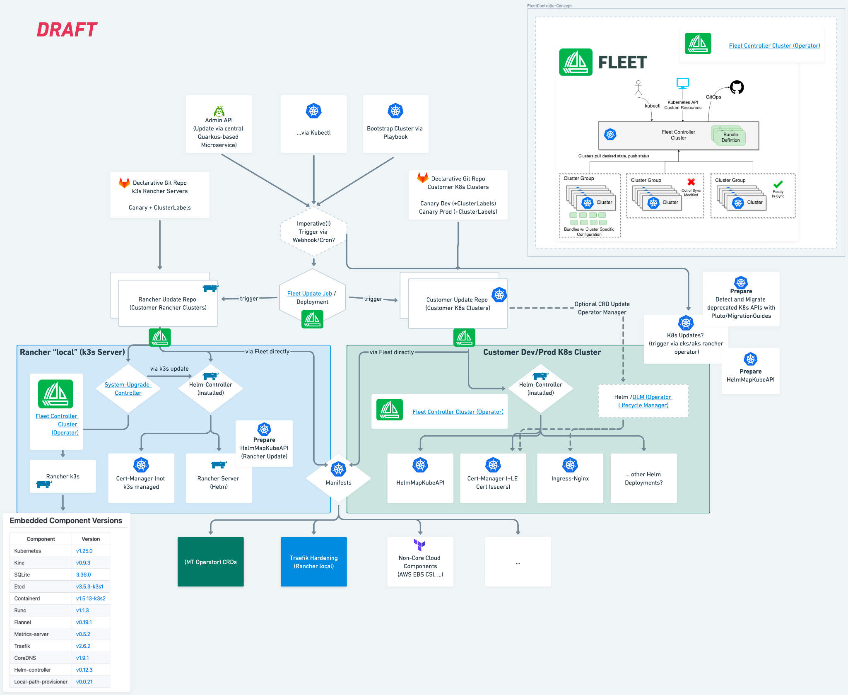
Updates on PaaS Infrastructure
Semi-Automated
  Continuously improving automated update process
Kubernetes API Migration
  Deprecated-API-Guide
  Maintain K8s Resources in your Codebase!
Magnolia-related Upgrades usually prepared/performed by Partner/Customer, supported by Magnolia Services
  Includes Helm
  Helm Version dictates Components

Slide 24
06
Q&A

